Slide 1
Higher Education Futures Meta-Themes
Forum on Reimaging Minnesota State
Innovative Models Session
April 4, 2019
Louis Soares
Chief Learning and Innovation Officer

Slide 2
Overview
ACE – Strategic Commitments
Pressures on Higher Education
A Framework for Innovation
Future Meta-Themes/Possible Futures
Discussion
Notes:
Update
Take back and promote a responsible way of rigorously framing the future of higher ed
Show headlines: cost, value, innovation (Carey)
Knowledge and Skills Demand
Finance/Affordability
Quality
Student Demographics
Core set of knowledge and skills that many would agree college graduates ought to acquire for intelligent citizenry, professional prosperity and personal satisfaction.
AACU Essential Learning Outcomes constitute a kind of took kit for a quality higher education.
Move from sage on the stage to quige

Slide 3
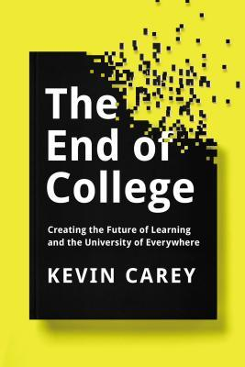
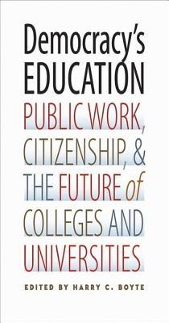

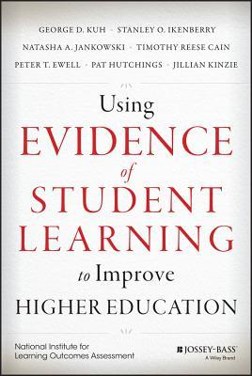
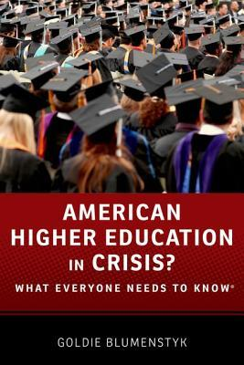
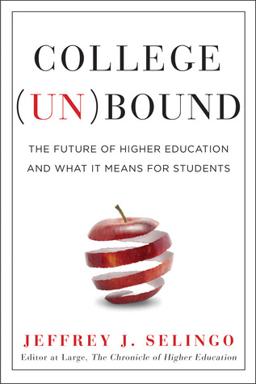
Notes:
Thought Leadership is a term derived primarily from the business literature.
It points to an ability to build an evidence based narrative that shapes the way the marketplace thinks about the future.
Amazon Top Sellers search on The future of higher education provided this sampling of books.
Three of which are more or less intended for broad public consumption – Carey Craig and Selingo and essentially assumed the unraveling of higher education as we know it.
Goldie – accepts the challenge laid by the first three and finds a less technology triumphalist world.
Kuh text is very specialised and interesting addition to a niche literature.
Which of these books is framing our public and national discourse right now?
I was excited to see Democracy’s Education on the list.
Board members may recognize that this book grew out of the work of the American Commonwealth Partnership of begun at the White House in 2012. Marking the 150th Ann. Of he Morril Act.
The editor Harry Boyte, a storied scholar of citizenship, in a standout introductory essay – renews a clarion call to higher education leaders that we have heard before….
…in higher education, where educators are experiencing an avalanche of changes: cost cutting, new technologies, and demands that higher education be narrowly geared to the needs of today's workplace. …….higher education is increasingly seen, and often portrays itself, as a ticket to individual success--a private good, not a public one.
Boyte concludes his essay with a challenge….. educators and their partners claim their power to shape the story of higher education.
From my perspective as a researcher I found myself asking the question, how can we as a community write an evidence driven narrative for the future of higher education that inspires policymakers and citizens while helping us to frankly take on the real challenges we face.

Slide 4
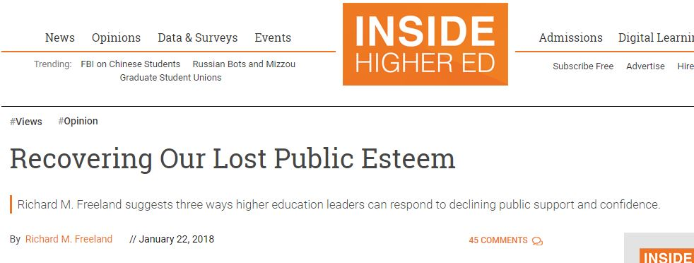
The value of college is declining in relation to benefits
Higher education is having a negative impact on the direction of the country
Colleges and universities are essentially businesses, more concerned with their own well-being than with educating students or serving communities
A May 2017 analysis of white working-class Americans found that 54 percent viewed investing in a college education as a “risky gamble,” while 61 percent of white working-class men felt that way (Public Religion Research Institute and The Atlantic).
Notes:
https://www.insidehighered.com/views/2018/01/22/three-ways-higher-ed-leaders-can-respond-declining-public-confidence-opinion

Slide 5
Membership Snapshot
1,526 Institutions and Systems
112 National and Regional Associations
82 Associate Members

Slide 6
MNSCU At A Glance
Enrollment 375,000
120,000 NC
Credentials 38,000+
7 – Four- year State Universities
30 – Two-year Community and Technical Colleges

Slide 7
Minnesota PSE Attainment

Slide 8
OUR VISION
A vibrant democratic society that relies on postsecondary education to expand knowledge, equity, and social progress.
OUR MISSION
ACE is a membership organization that mobilizes the higher education community to shape effective public policy and foster innovative, high-quality practice.

Slide 9
Strategic Commitments
Notes have been updated for new theme 2 information
Affirm and Strengthen Public Trust in Higher Education
Champion Access, Quality and Completion
Enrich the Capacity of Institutions and Leaders to
Adapt and Innovate
Notes:
Analytical frameworks include those found in research on educational equity, education policy, organizational and systems management, and disruptive innovation.
DIVERSITY AND EQUITY(demography of demand)
Over the last 40 years, college and university enrollment has quadrupled. This increased enrollment has many manifestations, not the least of which is an increase in the diversity of learners along any number of dimensions. Today’s higher education students represent many life stages and identities— racial/ethnic minority, single parent, veteran, immigrant, and at-risk young adult, to name only a few. While this diversity has been addressed in the scholarly and policy literature, it has been less explored as a systemic driver of reform and innovation in higher education.
CPRS believes that this perspective—a broader definition of diversity and its role as a driver of innovation—provides a foundation for research that will help higher education leaders and public policymakers frame the future together.
Dynamic and Resilient Institutions
As it has become apparent that higher education is in need of reform, institutional leaders and policymakers have to facilitate real structural and operational shifts if their campuses are to continue to serve people, communities, and economies effectively. They will need to better serve 21st century learners, create more sustainable resource strategies, and reinvent academic offerings, student services, and delivery models. Institutional leaders will have to harness the analytics revolution and manage change in order to innovate in ways that improve student outcomes, close attainment gaps, and create more sustainable campuses. CPRS seeks to provide college and university leaders with the insight, tools, and networks needed to successfully implement changes centered around equity and sustainability.
TRANFORMATIONAL LEADERSHIP
Today’s higher education executives are being called on to resolve a set of diverse challenges, including lost institutional capacity due to an aging workforce; financial sustainability linked to both revenue constraints and increasing benefits liabilities; and faculty and board engagement in ways that increase educational and research performance.
CPRS is poised to build on ACE’s expertise in benchmarking human capital with a focus on research that empowers higher education executives to lead through evidence-driven approaches to organizational change, stakeholder engagement, and issues of governance.
**********. Previous Theme 2 description ******
PUBLIC FINANCE
U.S. higher education innovation tends to occur at the intersection of public finance and institutional strategy. For example, while the Morrill Land-Grant Act and the G.I. Bill set the stage for the development of new types of institutions, the evolution of regional land-grant universities and community colleges has taken on different forms across the nation.
Today, amid greater demand for public accountability and increased educational attainment, colleges and universities are experiencing a rapidly shifting higher education landscape, including decreased state support, changing student demographics, and integration of technology.
CPRS approaches public and institutional finance research with analytical tools from the organization management and business model literature to explore ways to promote financially sustainable institutions with robust resources and systems to deliver high-quality, affordable higher education.

Slide 10
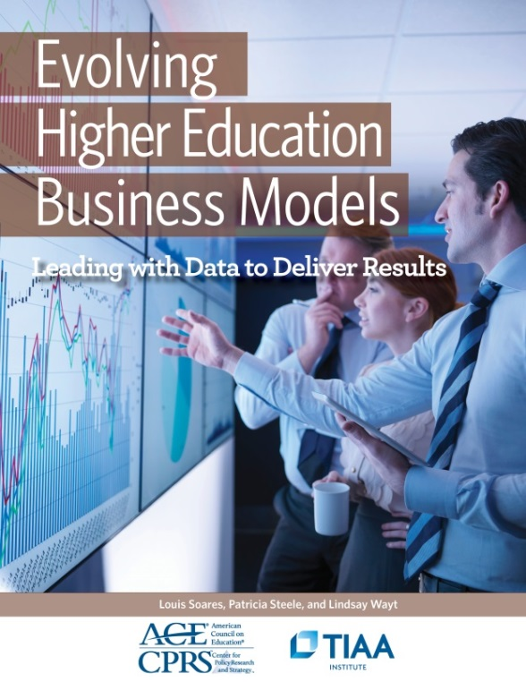
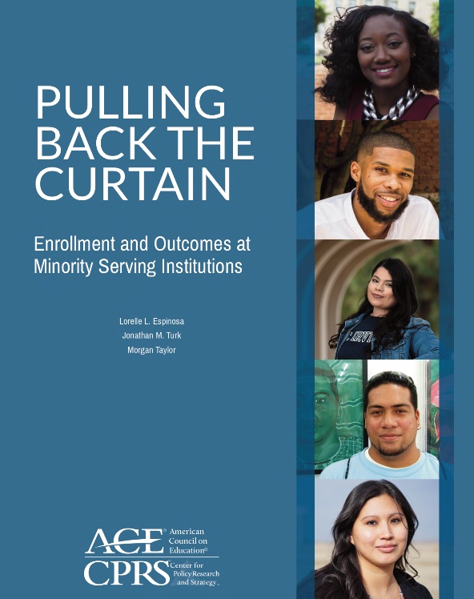
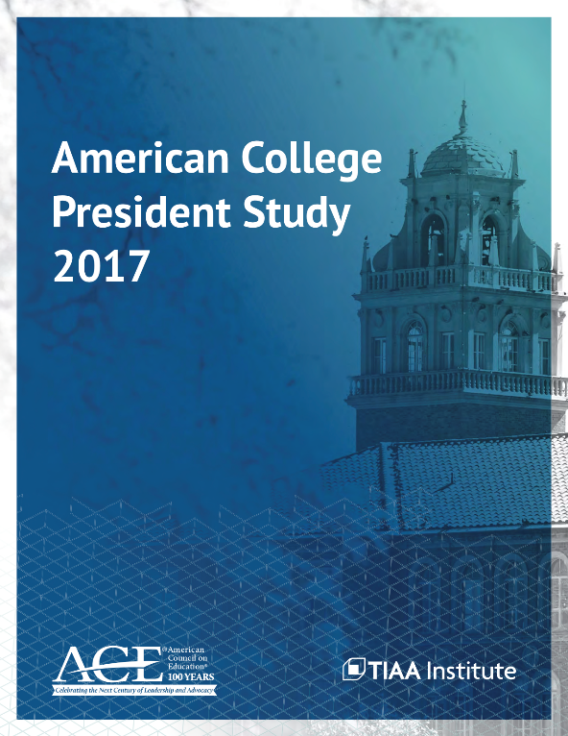
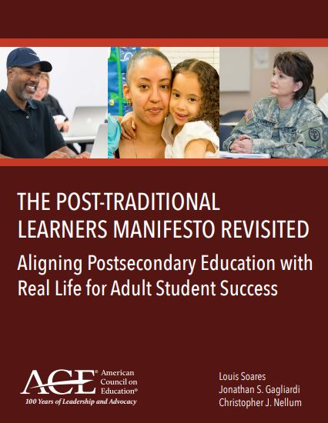
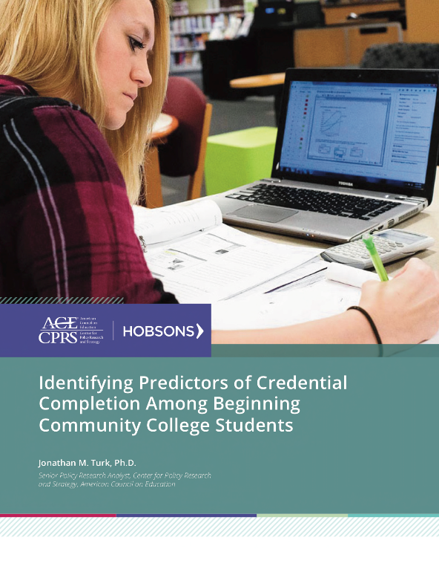
Notes:
338 institutions enrolling more than 2.7 million students and receiving more than 3 million applications each year
153 public, 185 private institutions
Median selectivity of 64 percent
50 highly selective institutions (<40% admitted)

Slide 11
Pressures on Higher Education

Slide 12
Global Economy in A Snapshot
787 Dreamliner
5 States
9 Countries
6 Languages
14 Suppliers
Global Value Chains
Standards-based
Technology-Driven
Cross-disciplinary Teams
Learning is built into Work

Slide 13
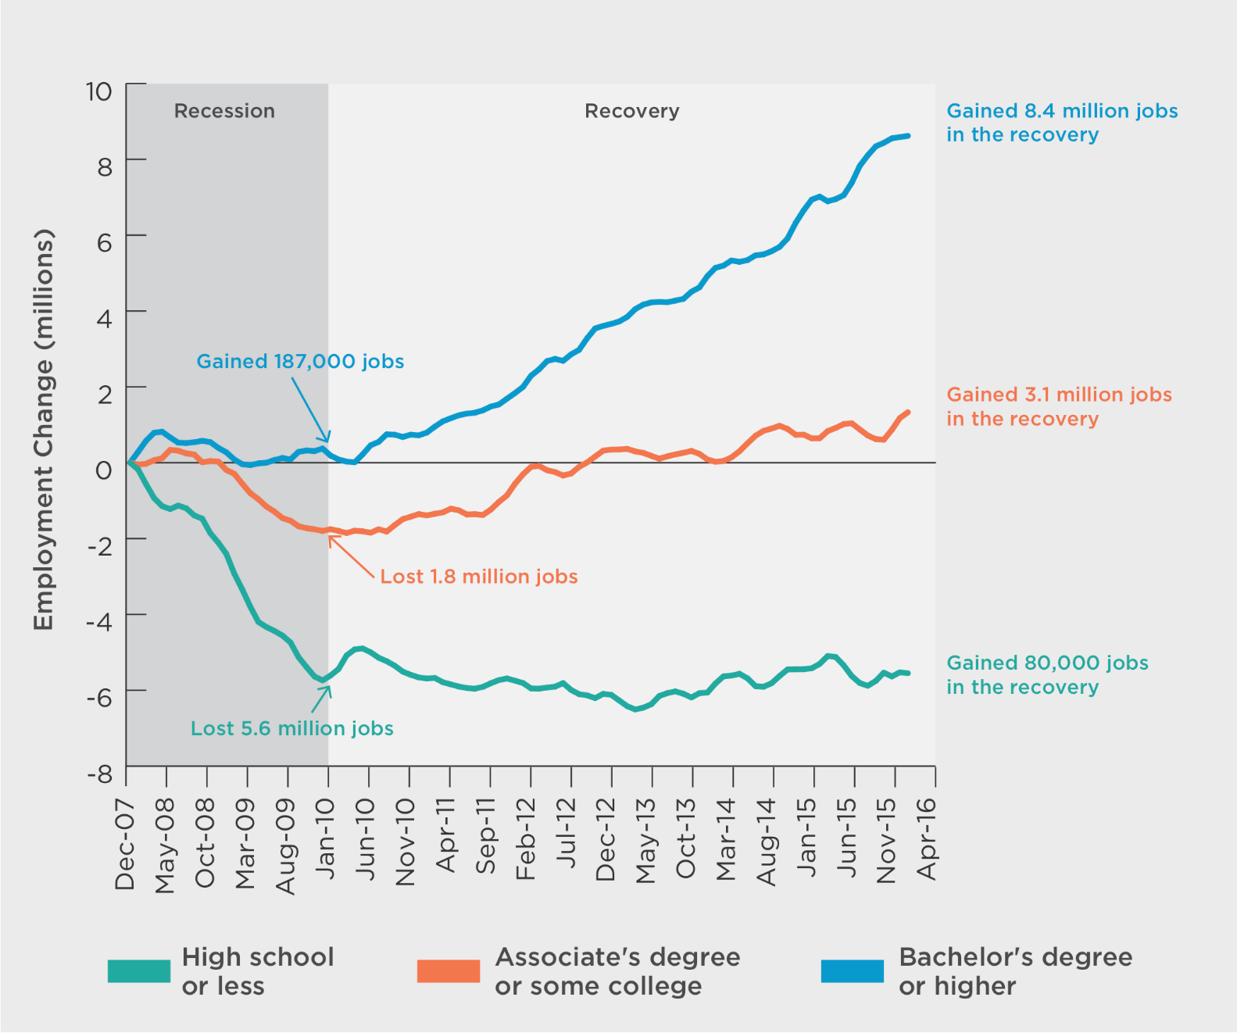
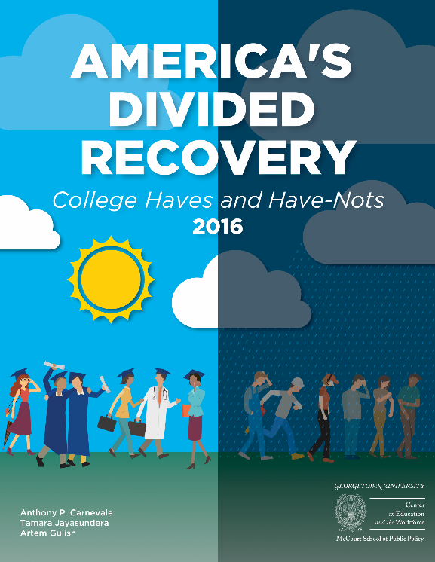
Workers with a Bachelor’s degree have added
8.4m jobs in the recovery
The shift has become even more stark when looking at employment data from after the recession. Employers are clearly demonstrating that they are hiring people who can prove that they can work with new information and have experience solving unstructured problems.
But those with only a high school diploma or less added only 80,000 after losing 5.6m jobs in the recession

Slide 14
Yet, an array of pressures are upending traditional postsecondary education
These pressures, in addition to changing political arena, have helped to create a public misunderstanding and/or mistrust about the value of colleges and universities and what we do.
Economic
Social
Technological
Accountability

Slide 15
College Affordability
A major factor behind this mistrust comes from families realizing the exponential growth in the upfront tuition and fees charged by colleges and universities – especially if compared to other sectors like health care or new housing prices or the general rate of inflation as demonstrated through the aggregate Consumer Price Index - while being shielded from drop off in appropriations and public funds that previously helped cover higher education costs but that no longer do.
Sources: U.S. Census, and U.S. Bureau of Labor Statistics
Notes:
No need to update--Jon

Slide 16
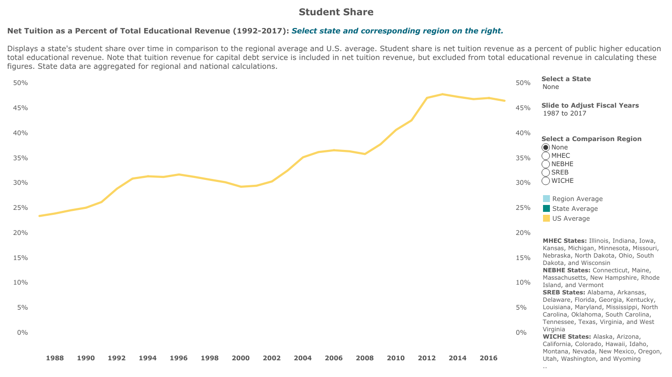
Students are footing more of the bill
In 1987, the student share of public higher education total educational revenues was 23%. By 2017 it had increased to 46%.
The student share of public higher educational revenues is expected to rise above 50% during the next economic downturn.
Source: State Higher Education Executive Officers. (2018). State higher education finance report: FY 2017.
Notes:
I’ve updated this with the newest data and walked it back to 1987 so you have 30 years worth of a trend--Jon

Slide 17
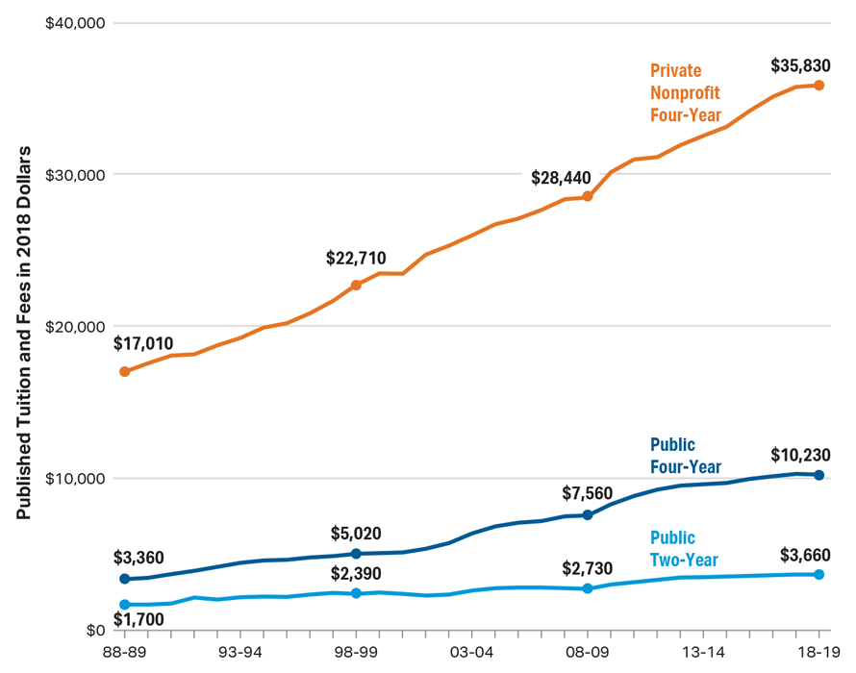
Tuition and fees continue to rise
Average Published Tuition and Fees in 2018 Dollars by Sector, 1988-89 to 2018-19
In 1987, the student share of public higher education total educational revenues was 23%. By 2017 it had increased to 46%.
The student share of public higher educational revenues is expected to rise above 50% during the next economic downturn.
Source: The College Board, Trends in College Pricing 2018, Figure 3.
Notes:
The 10-year dollar increases (in 2018 dollars) between 2008/09 and 2018/19 at public two-year colleges was $930; $2,670 at public four year institutions, and $7,390 at private nonprofit four-year institutions.
UPDATED--Jon

Slide 18
President & CEO Views on the Future of Funding Sources
70% of college presidents believe that both federal and state funding will either stay the same or decrease even more in the future
The majority of college presidents look at endowment income; tuition and fees; and private gifts, grants, and contracts as the funding sources that they will increasingly need to rely on
Source: ACE (2017), ACPS.

Slide 19
Change in Student Demographics
Notes:
Demand is robust 21 million according to NCES for 2012-14 academic year.

Slide 21
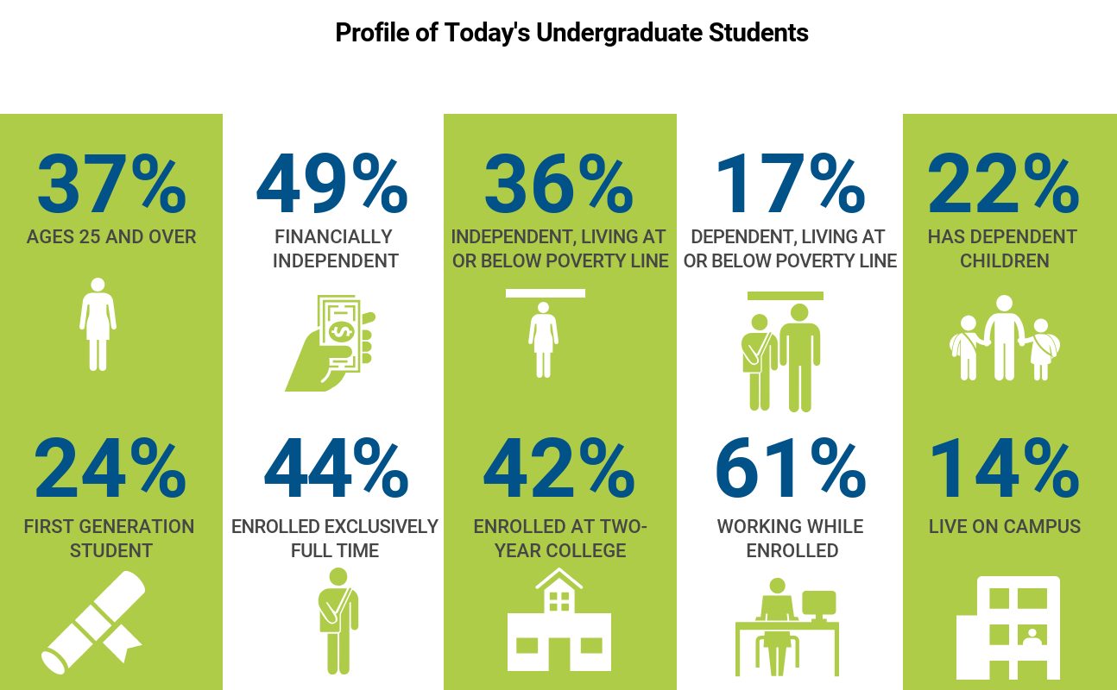
Profile of Today’s Post-Traditional Learner

Slide 22
Emergence of Post-Traditional Learners
Are needed wage earners for themselves or their families.
Combine work and learning at the same time or move between them frequently.
Pursue knowledge, skills, and credentials that employers will recognize and compensate.
Require developmental education to be successful in college-level courses.
Seek academic/career advising to navigate their complex path to a degree.

Slide 23
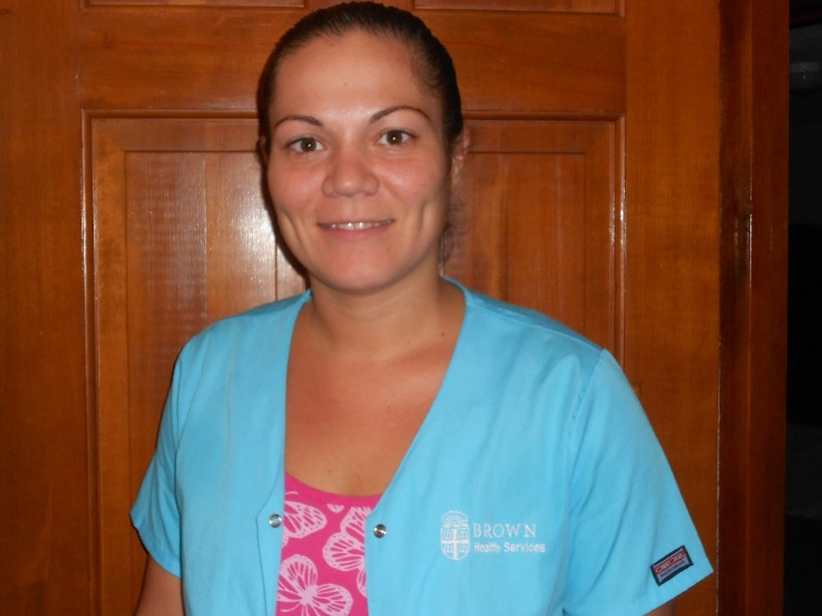
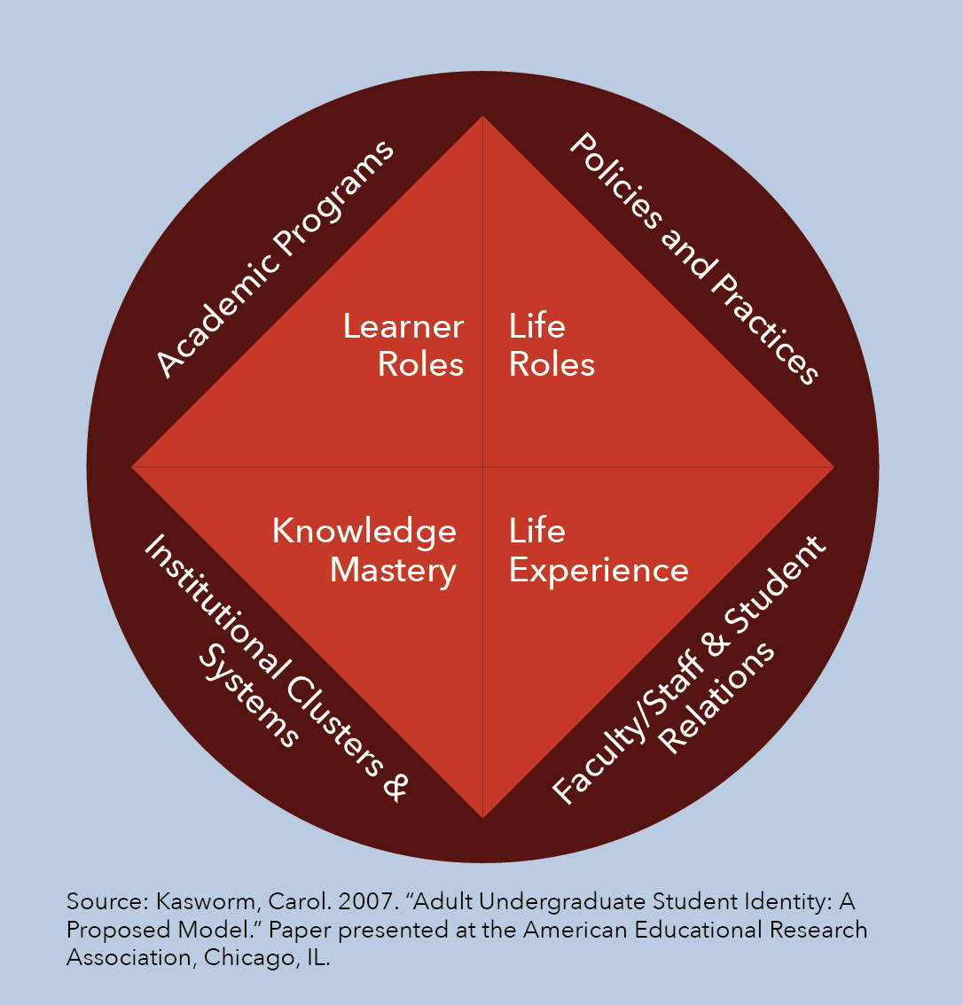
Adult Undergraduate Student Identity
TIFFANY M.
31 Years Old
11 years of PSE
Six colleges and universities
$29,000 in debt
5 repeated Gen Ed courses
Worked Full-time 9 of 11 years
Notes:
Learner roles. As an adult and undergraduate, the learner role is a reflection of a
post-traditional learner’s sense of positionality and agency as a learner and student
in the collegiate environment.
• Life roles. Similarly, as an adult undergraduate, life roles signify competing and
complementary roles, such as worker, family member, or community citizen, that
influence a post-traditional learner’s identification with the collegiate environment.
Life experiences. The life experience of post-traditional learners is shaped by their
maturational level and world view, linkages to the community, and beliefs about the
impact that furthering their education will have on their future.
• Knowledge mastery. Post-traditional learners come to the undergraduate environment
and classroom as adults with knowledge mastery, and derive meaning based in
part on their life experience, and in particular as members of the labor market.
Policies and practices. Post-traditional learners encounter an array of complex policies
(e.g., admissions, financial aid, degree requirements) in their efforts to navigate
college.
• Academic programs. Selecting an academic program is an important decision for
post-traditional learners who draw some of their motivation for attending college
from wanting a better job. Selecting wisely requires guidance, support, and insight.
• Faculty and staff relations. In order to successfully navigate a complicated set of
policies, practices, and academic programs, post-traditional learners require strong
connections to empathetic faculty and staff who prioritize meeting their needs
Institutional clusters and systems. Enrolling at multiple institutions is a reality for
some post-traditional learners. Stronger pathways between colleges would maximize
the value of each step in their education journeys.

Slide 24
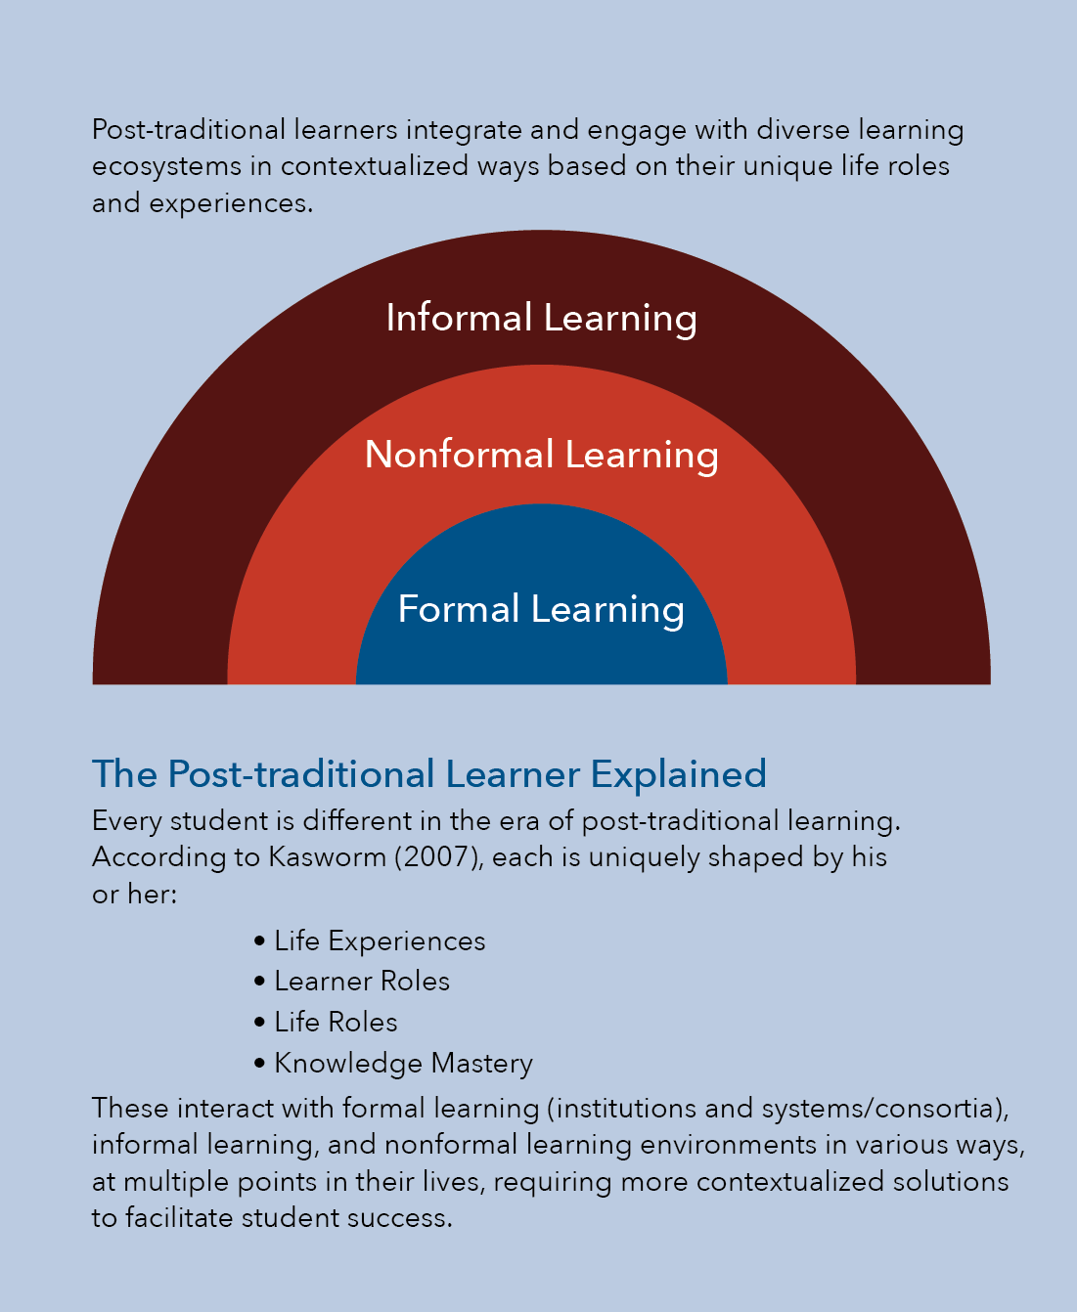
Learning Ecosystems and Optimizing Human Capital
Parenting
Car Repair
Music
Bible Study
Volunteering
OJT
Community-based Learning
4- year College
Community College
Vocation school
Notes:
Formal structure learning in education institutions credentials
Nonformal structured learning in non education institutions, maybe credentials can having outcomes
Informal learning – real life and interest driven learning, Learning conscious v. Task conscious learning

Slide 25
Learning Ecosystems and Optimizing Human Capital
Learning Identity
Service Member
(Worker)
Community
Member
Family
Student
Notes:
Formal structure learning in education institutions credentials
Nonformal structured learning in non education institutions, maybe credentials
Informal learning – real life and interest driven learning, Learning conscious v. Task conscious learning

Slide 26
Different Forms of College-Going
Modular, easy-to-access instruction
Blended academic and occupational curricula
Progressive credentialing of knowledge and skills (sub-degree level)
Financial, academic, and career advising
Public policy that reflects their complex task in balancing life, work and education
Notes:
This form of College going is marked by more customized pathways to degree/credential completion and a focus away from credit hours to the ability to demonstrate and apply knowledge.

Slide 27
Source: Education Dive, UPCEA

Slide 28
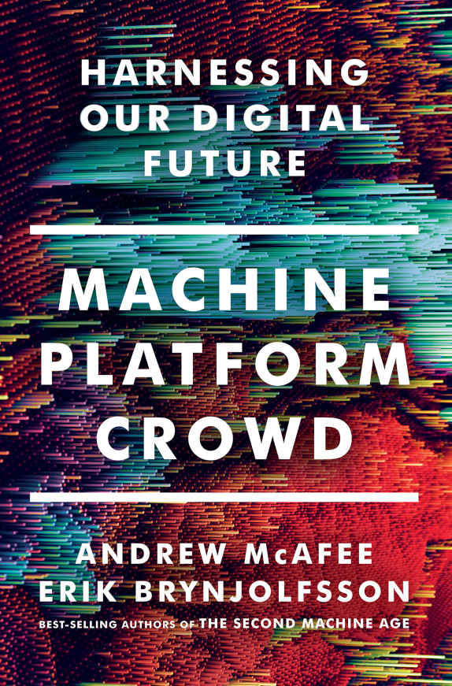
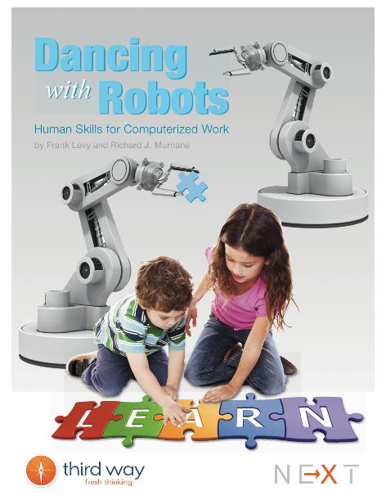
Technology and the Rise of the Expertise Economy
Shifting demands in what employers are looking for has pushed many of these post-traditional learners to seek out advanced education. This change in workplace skill demands is not new, but have maintained dominance since the early 2000s
Complex Communication
Expert Thinking
Routine Manual
Non-routine Manual
Routine Cognitive
Notes:
Technology is used by providers to perform more and more of the routine manual, cognitive, and transactional work
Jobs Change: Individual Competencies & Institutional Roles
Gained through experience.
Certification and Licensure
Required in Job Growth areas of healthcare, IT, Education, Green Tech
C/L require custom curricula and assessment with third party validation
Dynamic Labor Market requires occupational credentials for matching candidates with job requirements. Every year:
A third of the entire U.S. labor force changes jobs
30 million Americans work at jobs that did not exist in the previous quarter
Many occupations that workers have today did not exist five years ago
Early 2000s

Slide 29
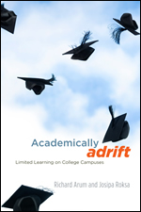
QUALITY IN QUESTION
Study of 2,300 undergraduates
  45 percent “demonstrated no significant gains in critical thinking, analytical reasoning, and written communications during the first two years of college”
  36 percent “demonstrated no significant gains in critical thinking, analytical reasoning, and written communications during the first four years of college”

Slide 30
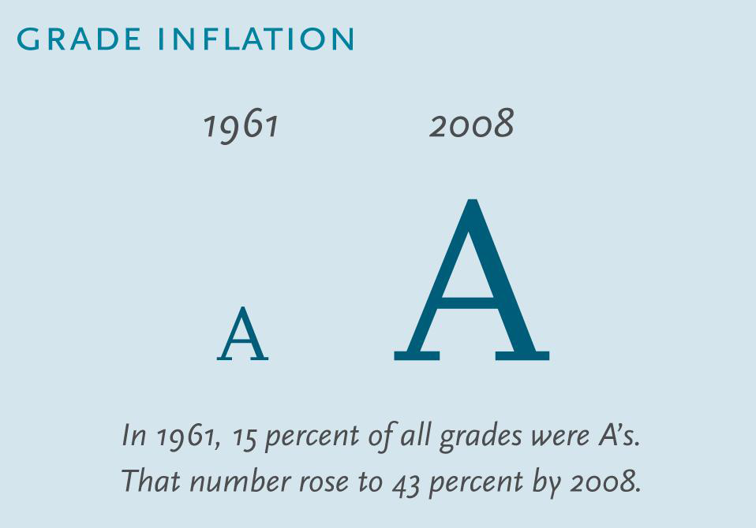
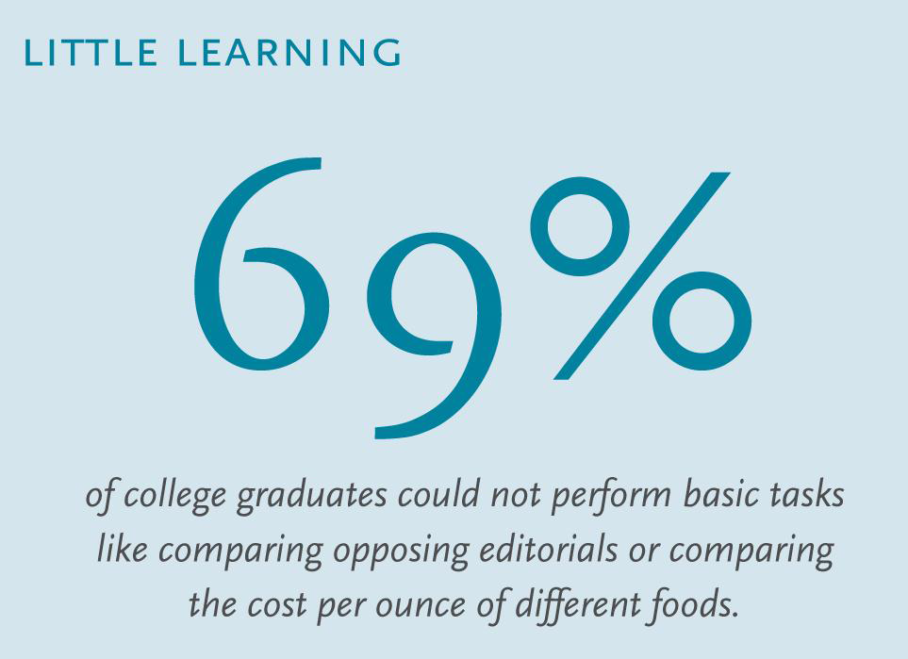
Quality is in Question
Source: Cracking the Credit Hour, Amy Laitinen, New America Foundation, 2012
Notes:
A 2006 study by the U.S. Department of Education’s National Center for Education Statistics found that the
majority of graduating college students lacked the basic skills necessary to summarize opposing newspaper editorial
arguments or correctly compare credit-card offers with varying interest rates. This study found alarming deficiencies
in three key areas: document, prose, and quantitative
literacy.
Only 25 percent of college graduates had the document literacy necessary to understand and use information
from noncontinuous texts, like interpreting a table about age, blood pressure, and physical activity. The results
weren’t much better when it came to prose and quantitative literacy since only 31 percent of college graduates could
take away lessons from a complex story or perform computations
like comparing the cost of food items per ounce
using numbers from printed materials.10
Sources: Stuart Rojstaczer and Christopher Healy, “Where A
Is Ordinary: The Evolution of American College and University
Grading, 1940-2009,” Teachers College Record 114, no. 7 (2012);
Mark Kutner, Elizabeth Greenberg, and Justin Baer, “A First Look at
the Literacy of America’s Adults in the 21st Century. NCES 2006-
470,” U.S. Department of Education National Center for Education
Statistics, (2006); Peter D. Hart Research Associates, How Should
Colleges Assess and Improve Student Learning? (The Association of
American Colleges and Universities, 2008).

Slide 31
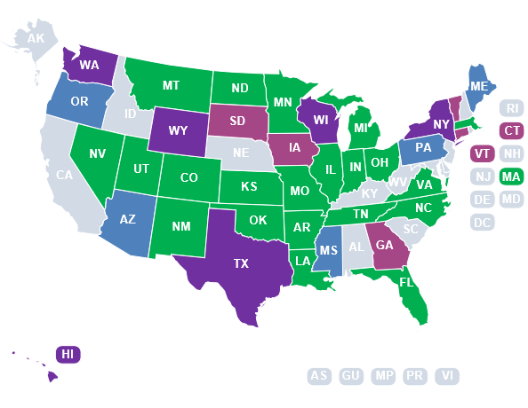
.
Performance Based Funding
In place at two-year institutions | In place at four-year institutions | In place at two-year and four-year institutions | In transition

Slide 32
Pressures on Higher Education
More Students
Fewer are Traditional
More Diversity in Learning Needs
Quality in Question
Pressure for Accountability
Less Money
INNOVATION IS IN ORDER
Notes:
The intentional discovery and application of ---
new institutional, instructional, credentialing and finance models—
that maintain quality and reduce costs and increase value

Slide 33
Framework for Postsecondary Innovation
Institutional
Models
Policy/Standards to facilitate change
Education
Partner
Networks
Technology
Tools
Notes:
Post Traditional Learners and the Transformation of Postsecondary Education: A Manifesto for College Leaders
In order to create effective thought leadership a framework for innovation is necessary to guide research:
I would suggest this framework which I adapted from Christensen’s work for my policy writing.
Value Network - Network of suppliers & partners with compatible & inter-dependent business models
Business Model Disruption in Value Network
Assessment and credentialing (e.g., professional certification)
Learning content development, distribution and management
Learning and research information services (e.g., library services)
Learning infrastructure services
Standards and Conformity assessment
Institutional and program quality assurance
Academic and technical skill and assessment standards
IT standards, including learning content
standards and data management standards
Quality assurance
Policy and regulatory Environment
Federal and state regulations
Institutional and program funding
Student grant and loan policies
Institutional and program accreditation
Federal and state data reporting
P-20 data infrastructures

Slide 34
Model of the College
Institutional Form & Governance
Instruction & Pedagogy
Credentials
Finance
Notes:
This slide represents a “theory of the college”, analogous to the “theory of the firm” used in the business literature to help frame research.
This would allows us to have a rough guide for how innovation would change the business model.

Slide 35
Model of Instruction and Pedagogy
Content
Knowledge
Applied and Meta-Skills
Social Networks
Credentials
Notes:
This further unbundling of instruction and pedagogy would allow for structuring analysis around this function of the college.
Applied means – writing a paper, doing a lab experiment, etc…
Meta-skills means - critical thinking, cross culture communication, problem solving
Social development and networks means --- growing up and building relationships for the future
Credentials – getting a document that says you know something.

Slide 36
Higher Education Meta-Themes
Now | Future
Learning Stocks | Learning Flows
Data Poor | Data Rich
Inputs | Output
Less organized | More (and Less) Organized
Academic v. Professional Prep | Academic & Professional Prep
Institution view | System view

Slide 37

Knowledge Stocks
Proprietary
Protect
Extract Value
Knowledge Flows
Networks of people/ideas
Collaboration
Refresh
Notes:
Computing power, storage and banwidth
Economic globalization and learning – dynamic and less stable states for
Economic Value is now coming from Knowledge flows.
From Knowledge stocks to Knowledge Flows
From institutions driven by scalable efficiency to institutions drive by scalable peer learning
From Stable to Dynamic environments
From Knowledge transfer to knowledge creation
most firms transfer knowledge more efficiently how do you create new knowledge. Contect relevant people inside and outside.
From Explict knowledge to tacit knowledge
From transactions to relationships
From zero sum to positive sum mindsets
From push platforms to pull platforms
a new digital infrastructure, built on the
sustained exponential pace of performance improvements in computing, storage, and
bandwidth, progressively transforms our business environment. This infrastructure
consists of institutions, practices, and protocols that together organize and deliver the
increasing power of digital technology to business and society.
In this wave intensifying competition and the increasing rate of change precipitated by the first wave shifts the
sources of economic value from “stocks” of knowledge to “flows” of new knowledge.
In this rapidly changing world, our stocks of knowledge (what we know) obsolesce more
quickly and success depends increasingly on our ability to tap into expanding and
diverse flows of knowledge to more rapidly refresh our depleting stocks of knowledge.
Knowledge flows are key to converting
challenges to opportunities
As the source of economic value creation shifts from stocks
to flows of knowledge in this era of intensifying competition
and more rapid change, participating in these flows
becomes essential if firms are to convert challenges to
opportunities. Currently the value that firms create is being
captured primarily by consumers and creative talent: they
have harnessed knowledge flows ahead of the firms and
they are reaping benefits at the expense of the firms. Consumers
enjoy lower prices and more alternatives, fueled by
access to information. Creative talent has benefited from
increased cash compensation. Firms have an opportunity to
participate in the same knowledge flows and networks and
rebalance that equation. Participating in knowledge flows
will also significantly "grow the pie" and move firms away
from a zero-sum game mindset that drives much of their
behavior today.
Participating in knowledge flows is mutually beneficial for
firms, talent, and consumers. The greater the firm’s participation
in knowledge flows, the more value they can create.
This value will be distributed between firms, talent and
consumers, but as they start offering more non-monetary
value to talent and consumers, firms have an opportunity
to retain an increasing share of the monetary value. Talent,
particularly the creative and passionate talent, is attracted
to firms that are rich in relationships, generate knowl

Slide 38
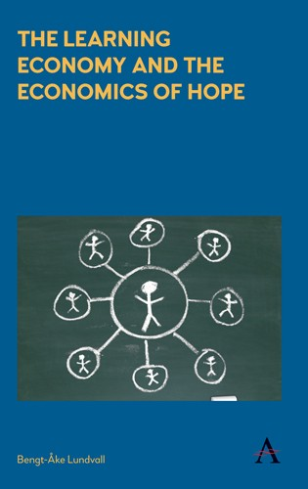
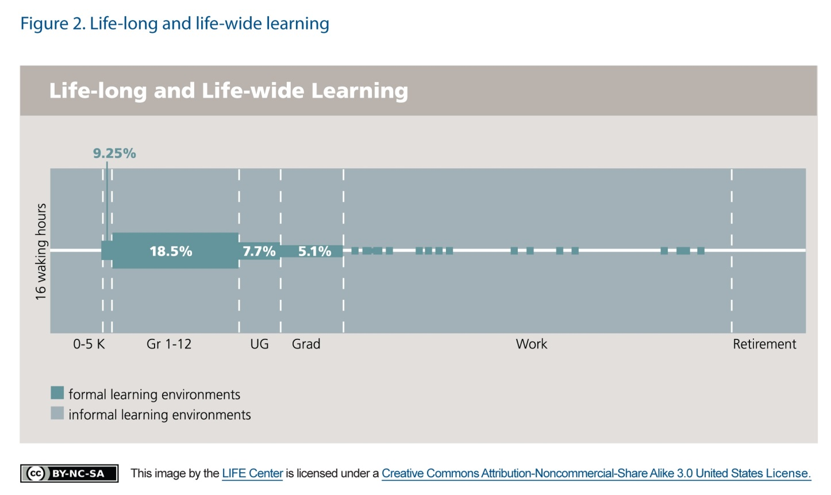
Learning Stocks to Learning Flows
Notes:
Learning intensivity – Bendt Ake Lundvall
The LIFE Center's purpose is to develop and test principles about the social foundations of human learning in informal and formal environments with the goal of enhancing human learning from infancy to adulthood.
LIFE Center (2005). "The LIFE Center's Lifelong and Lifewide Diagram". This diagram was originally conceived by Reed Stevens and John Bransford to represent the range of learning environments being studied at the Learning in Informal and Formal Environments (LIFE) Center (http://life-slc.org). Graphic design, documentation, and calculations were conducted by Reed Stevens, with key assistance from Anne Stevens (graphic design) and Nathan Parham (calculations).
FIGURE legend: Estimated time spent in school and informal learning environments. Note: This diagram shows the relative percentage of their waking hours that people across the lifespan spend in formal educational environments and other activities. The calculations were made on the best available statistics for a whole year basis on how much time people at different points across the lifespan spend in formal instructional environments. (Reproduced with permission of The LIFE Center.)
The LIFE Center represents a collaboration between the University of Washington in Seattle, Stanford University, and SRI International, Inc., both in the San Francisco area. The LIFE Center is a multi-institution Science of Learning Center funded by the National Science Foundation. The University of Washington is the lead institution.

Slide 39
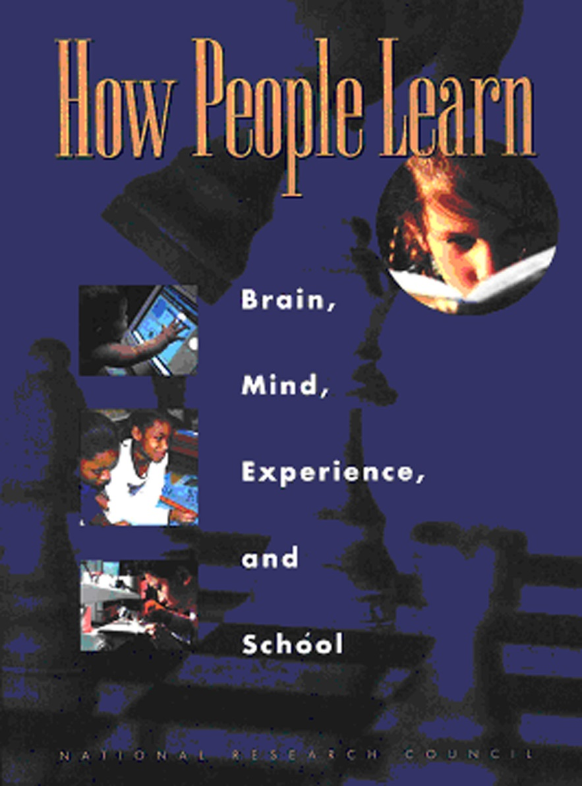
Learning Flows Yields Adaptive Expertise
10,000
Well organized body of knowledge
Supports understanding foundational concepts
Recognize patterns In the body of knowledge
Easy retrieval of relevant knowledge
Adaptive – metacognition allows transfer of knowledge to other settings
Notes:
Practice and Time.
Expert learners have well-organized knowledge, not just problem-solving strategies.
Expert knowledge is organized to support understanding, not just recall. And the organization is grounded in a field’s foundational concepts.
Expert knowledge is conditionalized, and the conditional relationships form patterns that experts recognize and rely upon.
An expert’s fluency allows the easy retrieval of relevant knowledge. The patterns mentioned in the previous point are second nature to the expert, while the novice struggles to recognize them. This fluency with fundamental patterns frees the mental energy to focus on new knowledge to add to the pattern.
There is a difference between adaptive experts, whose metacognitive skills allow the transfer of knowledge from one setting to another, and routine experts, whose expertise allows them to function well in standard settings but doesn’t serve them well when conditions are different.

Slide 40





BA: A Stock or A Flow?
1
degree
40
classes
120
credits
1600 hours
Source: Cracking the Credit Hour, New America Foundation.
Notes:
Most importantly, college
degrees came to represent the accumulation of credit
hours, typically 120 to earn a bachelor’s degree. But time
and learning are not the same. Two people can spend the
same amount of time in the same course and learn very
different things (see Figure 2).
Vygotsky – zone of proximal development
What is the minimum knowledge stock to perpetuate Adaptive expertise development

Slide 41
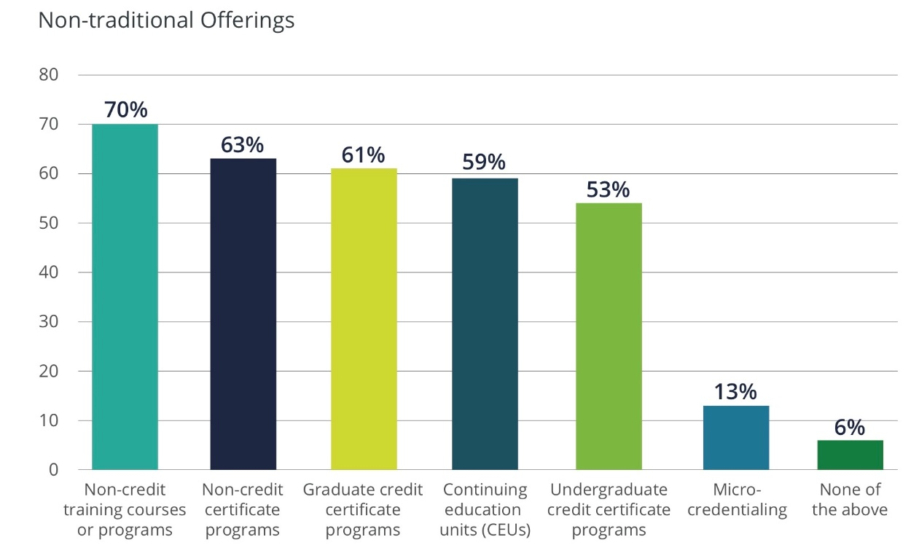
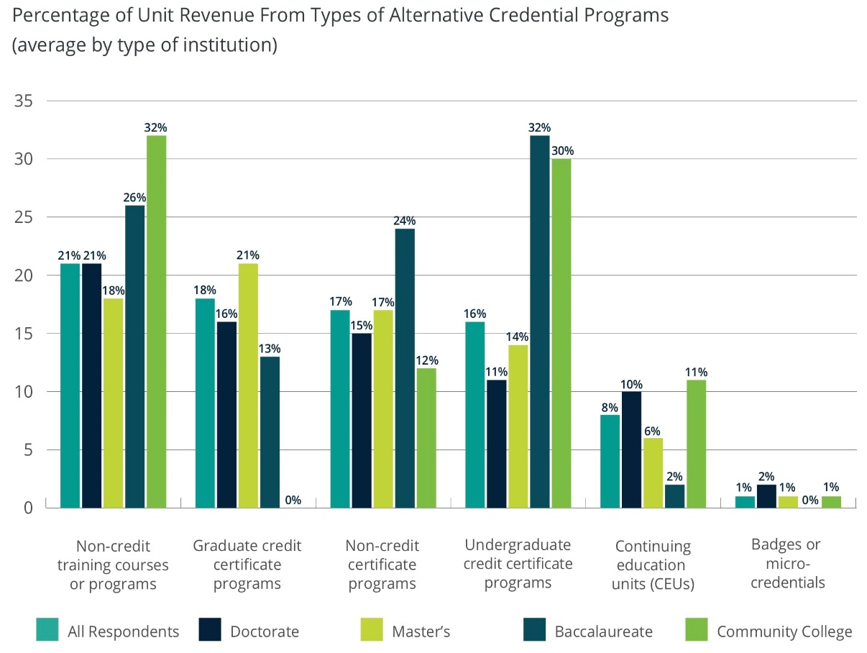
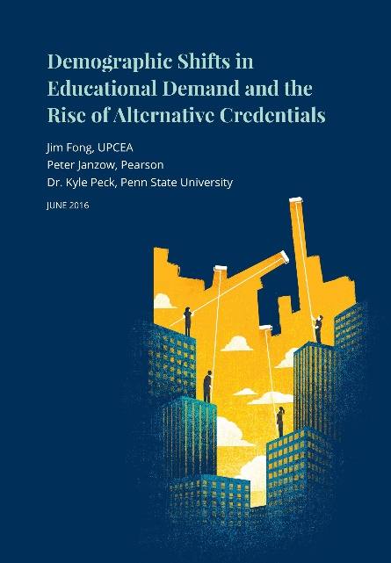
The Increasing Importance of Non-Degree
Credentialing
The Response from 190 Institutions (11% C.C., 12% Baccalaureate, 27% master’s colleges & univ, and 50% Doctoral granting)
Read as: 70% of respondents offered non-credit training courses or programs…ect.
32% of all unit revenue at community colleges came from non-credit training courses or programs …ect.

Slide 42





Data Poor to Data Rich
Notes:
Compliance to management
How many IPED surveys are there 9?

Slide 43
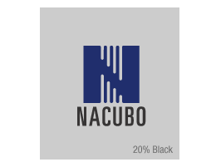
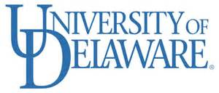

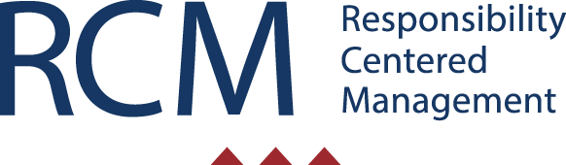
Data Poor to Data Rich
National Study of Instructional Costs and Productivity

Slide 44
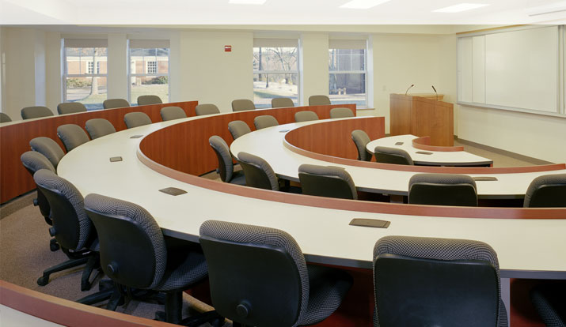
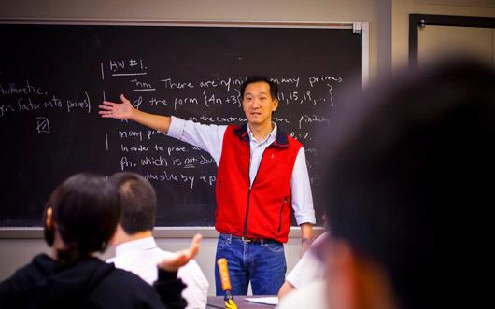
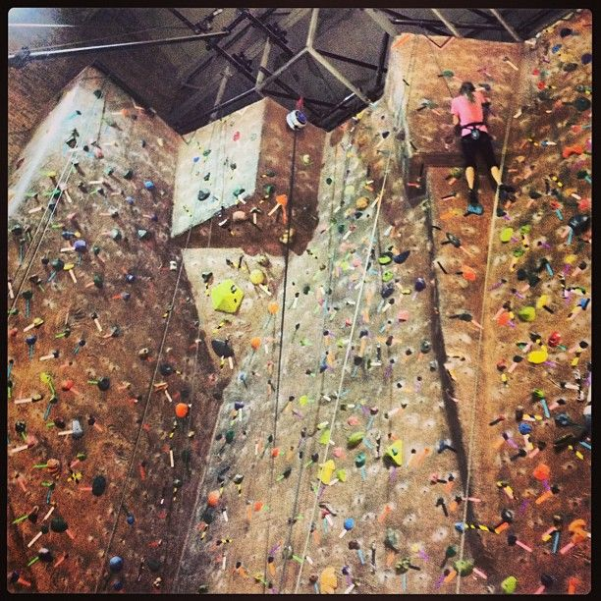

Inputs

Slide 45

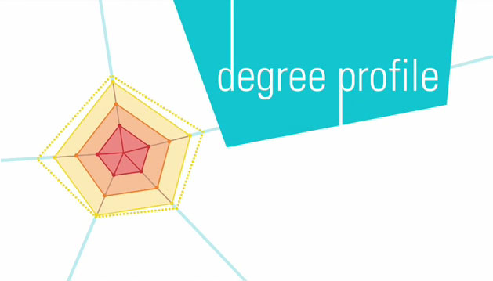

Outputs
College Scorecard
Notes:
30 instutitioins have CBE degree program over 600 experiments.

Slide 46
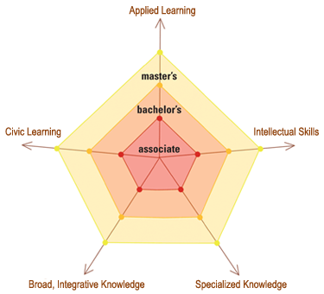
Five Dimensions of Learning Outcomes
Illustrates what students should be expected to know and be able to do once they earn their degrees.
Proposes learning outcomes to benchmark the associate, bachelor’s & master’s degrees.
Field Development in: 200 institutions, 30 states and six disciplines

Slide 47
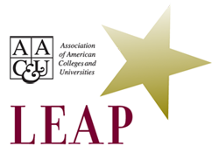
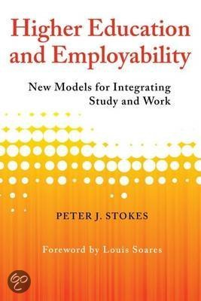
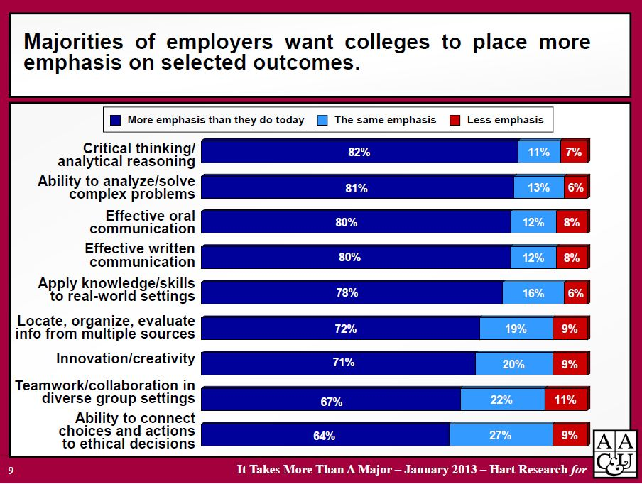
Academic/Professional Prep Integration
Notes:
Make Excellence Inclusive, LEAP Promotes
Essential Learning Outcomes—as a guiding vision and national benchmarks for college learning and liberal education in the 21st century
Principles of Excellence—offering both challenging standards and flexible guidance for an era of educational reform and renewal.
High-Impact Educational Practices—ways of engaging and challenging students—such as first year programs; intensive writing, collaborative assignments, undergraduate research, internships, and major projects that help students achieve essential learning outcomes
Authentic Assessments—using students’ own work and faculty-validated rubrics, probing whether individual students have developed essential capacities, and can apply their learning to complex problems and real-world challenges.
Students’ Signature Work—challenging higher education to prepare all students to complete a substantial cross-disciplinary project in a topic significant to the student and society, as part of the expected pathway to a degree. The signature project can take one of many forms (e.g. capstone, internship, field work, research, community-based research).

Slide 48
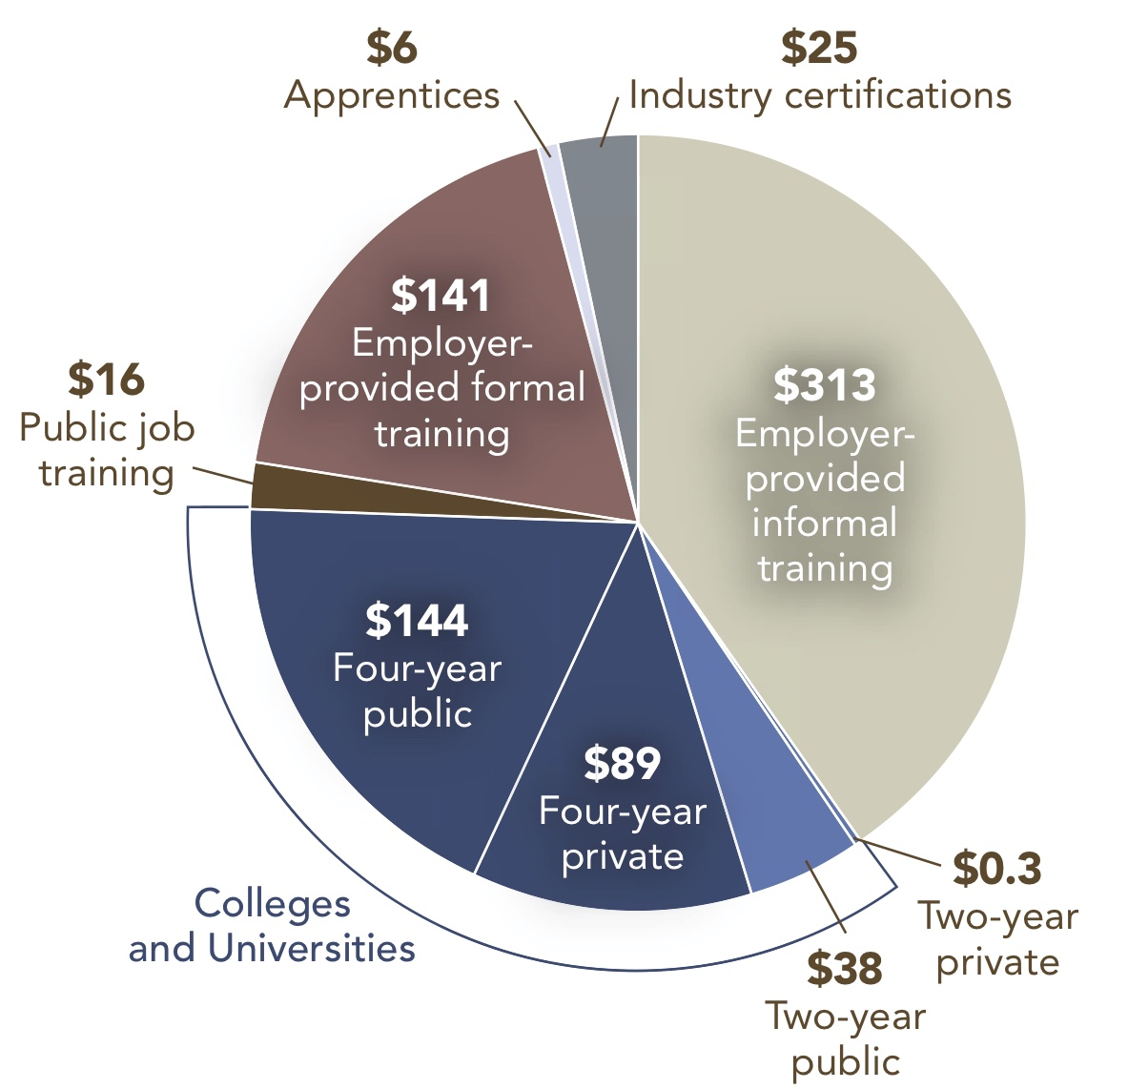
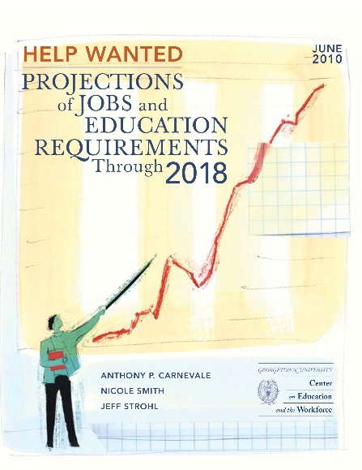
Academic & Professional Prep = $772B
Non-credit PSE
Est. # served 22 million
Credit PSE
Est. # served 21 million
Notes:
$772 billion annually on PSE and training. 65 % spend outside formal Higher education system
PSE Ed and Training Is changing. Become steward of new system. Corporate University
$500 billion is invested in educating adults outside of the formal higher education system.
In tight budget environments how can higher education tap into more of this investment?
Source: Authors’ calculations using data from Integrated Postsecondary Education Data System (IPEDS), Department of Labor Employment and Training Administration (DOLETA), American Association of Community Colleges (AACC), Office of Vocational and Adult Education (OVAE), Survey of Employer Provided Training (DOL), and Bureau of Labor Statistics (BLS)

Slide 49
Life-Wide Learning
Non-Credit Postsecondary Education and training
Type
Employer Training
Apprenticeships
Public Workforce Training
Military
Volunteer Experiences
Providers
Business Community
Community-base organizations
Cross-sector partnerships
Community colleges
Armed Forces
Proprietary Firms
Online Providers of Content
Credit-bearing Postsecondary
Education and training
Type
Credit-bearing Courses
Providers(accredited)
Public 2-year
Public 4-year
Private 2-year
Private non-profit 4-year
Private for-profit 4-year
Emerging Ecosystem
To Validate Non-credit Learning and Beyond
Notes:
To meet the demands of the labor market for PS knowledge and skills and to meet the demand to educate more adult learners in a cost- effective manner.
An ecosystem is forming around the need to validate learning that is occurring in non-credit environments -- to capture prior learning to better engage adult learners, help them persist, decrease time to and reduce cost of degree.
The ecosystem is comprised of many players public and private, for-profit and not-for-profit, traditional and technology-enabled. The governing rules of the ecosystem are still forming.

Slide 50



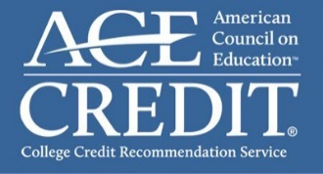
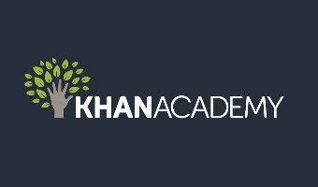



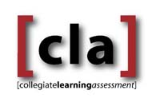

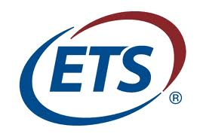

New Learning Ecosystem
“College”
General Education
Exams/
Assessment
Badges/
Competency
Credit for Prior Learning
Ubiquitous Learning Resources

Slide 51
Less Organized
Institutional Form & Governance
Instruction & Pedagogy
Credentials
Finance
Senior Administrators &
Board
Faculty
Academic Committees
Hidden cross subsidy
Separation from productivity
Academic Committees
Notes:
This slide represents a “theory of the college”, analogous to the “theory of the firm” used in the business literature to help frame research.
This would allows us to have a rough guide for how innovation would change the business model.

Slide 52
More Organized
Institutional Form & Governance
Instruction & Pedagogy
Credentials
Finance
Evidence-based
Governance
Student Level
Learning Data
Transparent Financials drive performance
Transparent and Portable Learning
Outcomes
Notes:
This slide represents a “theory of the college”, analogous to the “theory of the firm” used in the business literature to help frame research.
This would allows us to have a rough guide for how innovation would change the business model.

Slide 53
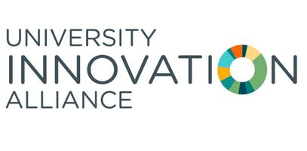
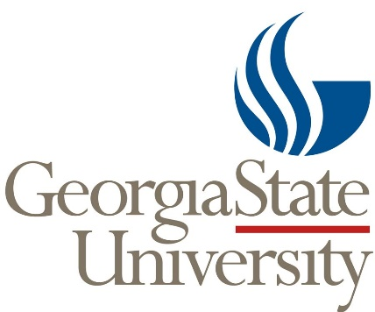



NOVA
(19,200 Full time & 32,700 Part time)
Harper College - (Illinois – outside Chicago- 5,600 full 9,200 part time, 12.5-24% Hispanic/Latino)
United Tribes Technical College (North Dakota – Under 1,000 Enrolled – 82% Native American)
Tallahassee CC (FL – About 6,800 full & 7,400 part time enrolled, 20-40% Afrocan Amer/Black & 12.5% Latino)
Notes:
Big Data
Predictive analytics
Intrusive advising
Structured Degree Pathways.

Slide 54


World Literature 101 Course Redesign
Old delivery: 20 face-to-face lecture sections (about 60 students each)
New delivery: 800-student online section organized around 4-week modules
Technology enabler: web-enabled instruction and assessment/
Staffing: program coordinator, 4 faculty, 4 grad students,
Outcomes and Savings:
    student outcomes better,
    reduced costs by over 50 %,
    tripled number of student the faculty can handle
Notes:
Business Model:
Value Proposition: More students, served with better outcomes
Resources: program coordinator, 4 faculty, 4 grad students,
Processes: modularized delivery online content, Pre and Post Quiz, WebCT writing assignments, immediate feedback to learners
Profit formula: student outcomes better, reduced costs by over 50 %, tripled number of student the faculty can handle

Slide 55
(And Less Organized - Unbundled)
Institutional Form & Governance
Instruction & Pedagogy
Credentials
Finance

Slide 56




Micro-Credentials to Degrees
MIT Unveils
‘MicroMaster’s,’
Allowing Students to
Get Half Their Degree
From MOOCs
Master of Computer Science
Notes:
MIT is piloting a MicroMaster’s credential, awarded to students who complete the first half of the supply chain management master’s program online in MOOC format.
The Chronicle of Higher Education reports that students who complete the first semester of courses online and pass a “comprehensive proctored examination” will get preference in the admissions process for the final portion of the master’s degree on campus.
After spending just one semester on campus, students who do the first half of the coursework online can walk away with an MIT master’s degree.
Unbundling degree programs is one way traditional higher education is innovating to compete with flexible, nontraditional programs. MOOCs cannot replace a college degree. That’s clear by now, nearly a decade after the original massive open online courses began in earnest. But they can open access to certain content that prepares students for a degree program.
MIT’s pilot could also work to diversify the student body in its master’s in supply chain management program. Students who may not rise to the top of the applicant pool with their prior grades can now prove themselves by completing half of the degree online.
Udacity
Georgia Tech, Udacity, and AT&T have teamed up to offer an online Master´s degree in Computer Science—the first of its kind delivered through a MOOC platform. This is a whole new way to advance your knowledge and skills with advanced computer science classes. And there are flexible options for learning with us: you can apply for the full degree through Georgia Tech or take individual classes with the Udacity full course experience.

Slide 57
General
Assembly

Slide 58




New Credentials - Overthrow BA Hegemony
AP in English language and AP Statistics
Work Experience
Occupational Credential
Knowledge Worker Journeyman License
Adaptive Experts
T-Shaped Professionals

Slide 59







Reverse the Campus
A Dorm for All Colleges
November 4, 2012
Notes:
Self-organized teams of individuals.
Work on projects to develop knowledge and skills.
Support and share resources for team and individual learning goals. Credly empowers the recognition of lifelong achievement by offering the leading platforms for verifying, sharing and managing digital badges and credentials.
Thousands of organizations, including the New York City Department of Education, Adobe, SUNY, University of Central Florida, Dallas Museum of Art, MoMA, EDUCAUSE, Instructure, Training Magazine, Yale University, Harvard, the YMCA of Greater New York, Smithsonian, and NMC, use Credly to make achievements visible.

Slide 60
Institution View to System View

Slide 61
Students are Mobile
This slide has been updated – Previously used NCES 2005 data – I used same terms but updated to NCES 2014 data.
(36% attended more than one school, of the students who attended more than one school, 68% attended two colleges, and 32% attended more than 2)

Slide 62

21st Knowledge for Individual/Business Success
Industry/Sector Knowledge
General Knowledge
Firm/Agency Specific
Knowledge
Job/Occupational
Knowledge
Notes:
Lepak, D., and S. Snell. 2003. “Managing the Human Resource Architecture for
Knowledge-Based Competition.” In S. Jackson, M. Hitt, and A. DeNisi, eds.,
Managing Knowledge for Sustained Competitive Advantage: Designing Strategies
for Effective Human Resource Management. San Francisco: Jossey-Bass, pp.
127–54.
General knowledge, is primarily acquired primarily through formal schooling, and refers to such academic competencies as analytic skills, quantitative reasoning, written and oral communications, critical thinking, and problem-solving skills as well as mastery of specific subjects or disciplines.
Occupation-specific knowledge pertains to specific jobs or occupations and may be acquired through formal education, training, on-the-job experience, or some a combination of these, depending on the occupation.
Firm- or agency-specific knowledge may result from some combination of formal schooling, training, and on-the-job experience and is, by definition, unique to the firm.
Industry-specific knowledge can also be acquired through either experience or formal schooling, but in an increasing number of industries significant levels of both experience and education are required.
Is this what you were referring to by “both”? I think spelling it out is helpful for clarity.

Slide 63
20th Century
Postsecondary Education
Graduate/Professional Schools
Industry/Professional
Knowledge
General
Knowledge
4-Year Colleges and Universities
BS/BA Degrees
Community College
AA/AS (Transfer) Degrees
Community College
AA/AS (Transfer) Degrees
Firm/Agency
Knowledge
Job/Occupational
Knowledge
Community College Vocational/Technical
Certificates and AAS Degrees
Employer Sponsored Training.
Union-Employer Sponsored Training,
Proprietary School Job Training,
On-the-job Training, and
Work/Life Experience
Strong Link Weak Link

Slide 64
Toward a
21st Century Structure
Graduate/Professional Schools
Industry/Professional
Knowledge
General
Knowledge
4-Year Colleges and Universities
BS/BA Degrees
Community College
AA/AS (Transfer) Degrees
Firm/Agency
Knowledge
Job/Occupational
Knowledge
Community College Vocational/Technical
Certificates and AAS Degrees
Employer Sponsored Training,
Union-Employer Sponsored Training,
Proprietary School Job Training,
On-the-job Training, and
Work/Life Experience
Strong Link Weak Link

Slide 65
21st Century Higher Education
System Characteristics
Learner Centered
Technology Enabled (learning and management)
Faculty guided and curated
Intentionally geared to career and life success
Provide stackable recognized credentials
Incorporate non-collegiate e.g. apprenticeship
Eliminate “transfer tax”
Different “models” for different institutional missions
Notes:
don’t make everyone Harvard or Rio Salado.

Slide 66
Thank You
Questions

