Slide 1
TRANSITIONS
January 2019

Slide 2
January 10 Webinar AGENDA
Expectations for consortia leaders
Resources
Opportunities
Timeline
How can we help?
FAQ (or what you would find helpful)

Slide 3
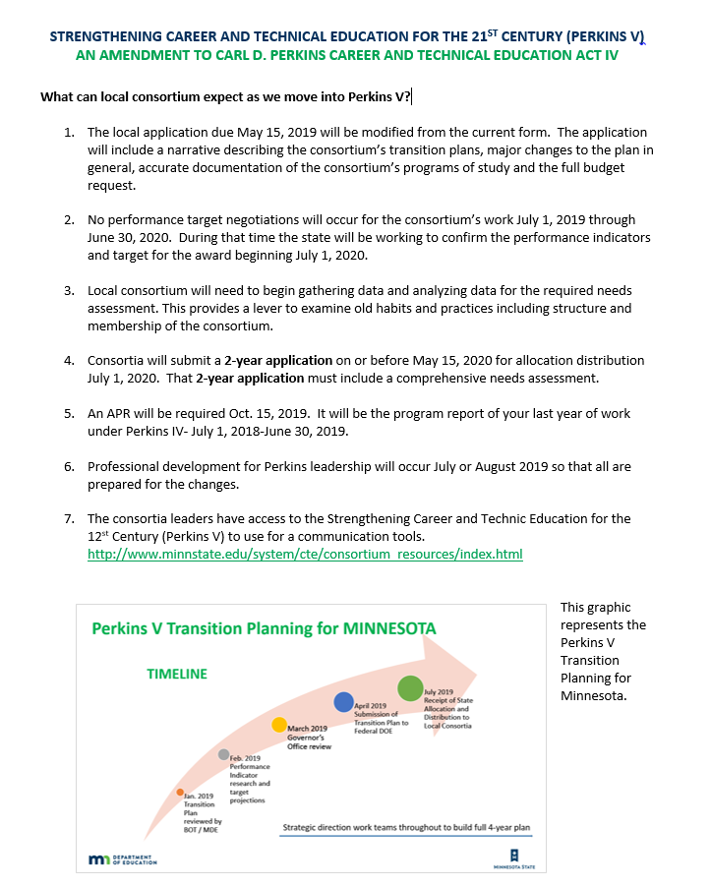

Slide 4
What can consortium expect?
The local application due May 15, 2019 will be modified from the current form. The application will include a narrative describing the consortium’s transition plans, major changes to the plan in general, accurate documentation of the consortium’s programs of study and the full budget request.
No performance target negotiations will occur for the consortium’s work July 1, 2019 through June 30, 2020. During that time the state will be working to confirm the performance indicators and target for the award beginning July 1, 2020.
Notes:
Major Changes- Examples would include personnel changes and record of request for changes that were part of reallocation or allocation.

Slide 5
What can consortium expect?
3. Local consortium will need to begin gathering data and analyzing data for the required needs assessment. This provides a lever to examine old habits and practices including structure and membership of the consortium.
4. Consortia will submit a 2-year application on or before May 15, 2020 for allocation distribution July 1, 2020. That 2-year application must include a comprehensive needs assessment.
Notes:
Major Changes- Examples would include personnel changes and record of request for changes that were part of reallocation or allocation.

Slide 6
What can consortium expect?
5. An APR will be required Oct. 15, 2019. It will be the program report of your last year of work under Perkins IV- July 1, 2018-June 30, 2019.
6. Professional development for Perkins leadership will occur July or August 2019 so that all are prepared for the changes.
7. Professional development for Perkins leadership will occur July or August 2019 so that all are prepared for the changes.
Notes:
Major Changes- Examples would include personnel changes and record of request for changes that were part of reallocation or allocation.

Slide 7
Resources
1. Slide deck with notes
http://www.minnstate.edu/system/cte/consortium_resources/index.html
2. One pager
Leadership
Faculty/teacher (in development)
3. Webinars (What would be helpful?)
Assessment Tools (RealTimeTalent/DEED)
Potential
Centers of Excellence
Performance Indicators
4. Templates- Survey/focus group templates (in development)

Slide 8
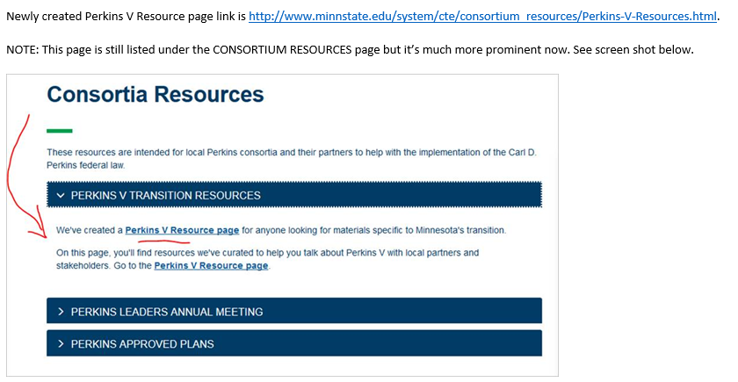
Resources

Slide 9
Minnesota’s Planning for Perkins V
Vision
Advancing career and technical education empowers every learner to realize a rewarding career
Mission
Quality career and technical education ensures every learner has equitable access to career-connected learning through a network of knowledgeable partners
Principles:
We are committed to ensuring
An equity lens for all decision-making
Inclusion of all stakeholders
Being bold, innovative, and focused on continuous improvement
Responsiveness to the evolving labor market
Notes:
This slide is a working draft from the initial Perkins V Minnesota planning team who attended Region C Perkins Planning facilitated by Advance CTE, NAPE, OCTAE, ACTE. Representatives included Minnesota State, MDE, MACTA, MnACTE, consortia leaders- secondary and postsecondary, and ABE.
Process: planning group with assistance from Advance CTE, NAPE, ACTE proposed these elements. This is just the beginning. We will continue to seek input from many stakeholder groups.

Slide 10
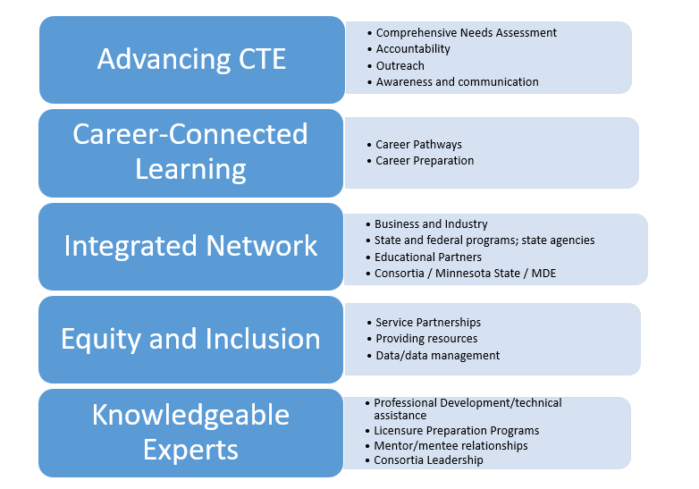
Opportunities- Strategic Directions

Slide 11
How can we help?
FAQ or other methodology of gathering questions and answers?
Templates

