Slide 1
January 2019
CONSORTIUM
Strengthening Career and Technical Education for the 21st Century (Perkins V)
An amendment to Carl D. Perkins Career and Technical Education Act IV
Notes:
Consortia may consider playing the campaign video:
https://careertech.org/campaign-video
New CTE campaign video

Slide 2
National Vision for CTE
Career Technical Education is an educational option that provides learners with the knowledge and skills they need to be prepared for college, careers and lifelong learning. CTE gives purpose to learning by emphasizing real-world skills and practical knowledge within a selected career focus.
Our vision is to transform and expand CTE so that each learner – of any background, age and zip code – is prepared for career and college success.
Our strategic priorities:
All CTE programs are held to the highest standards of excellence
All learners are empowered to choose a meaningful education and career
All learning is personalized and flexible
All learning is facilitated by knowledgeable experts
All systems work together to put learner success first
https://careertech.org/vision
Notes:
Source: Advance CTE
State Leaders Connection Learning to Work
https://careertech.org/vision

Slide 3
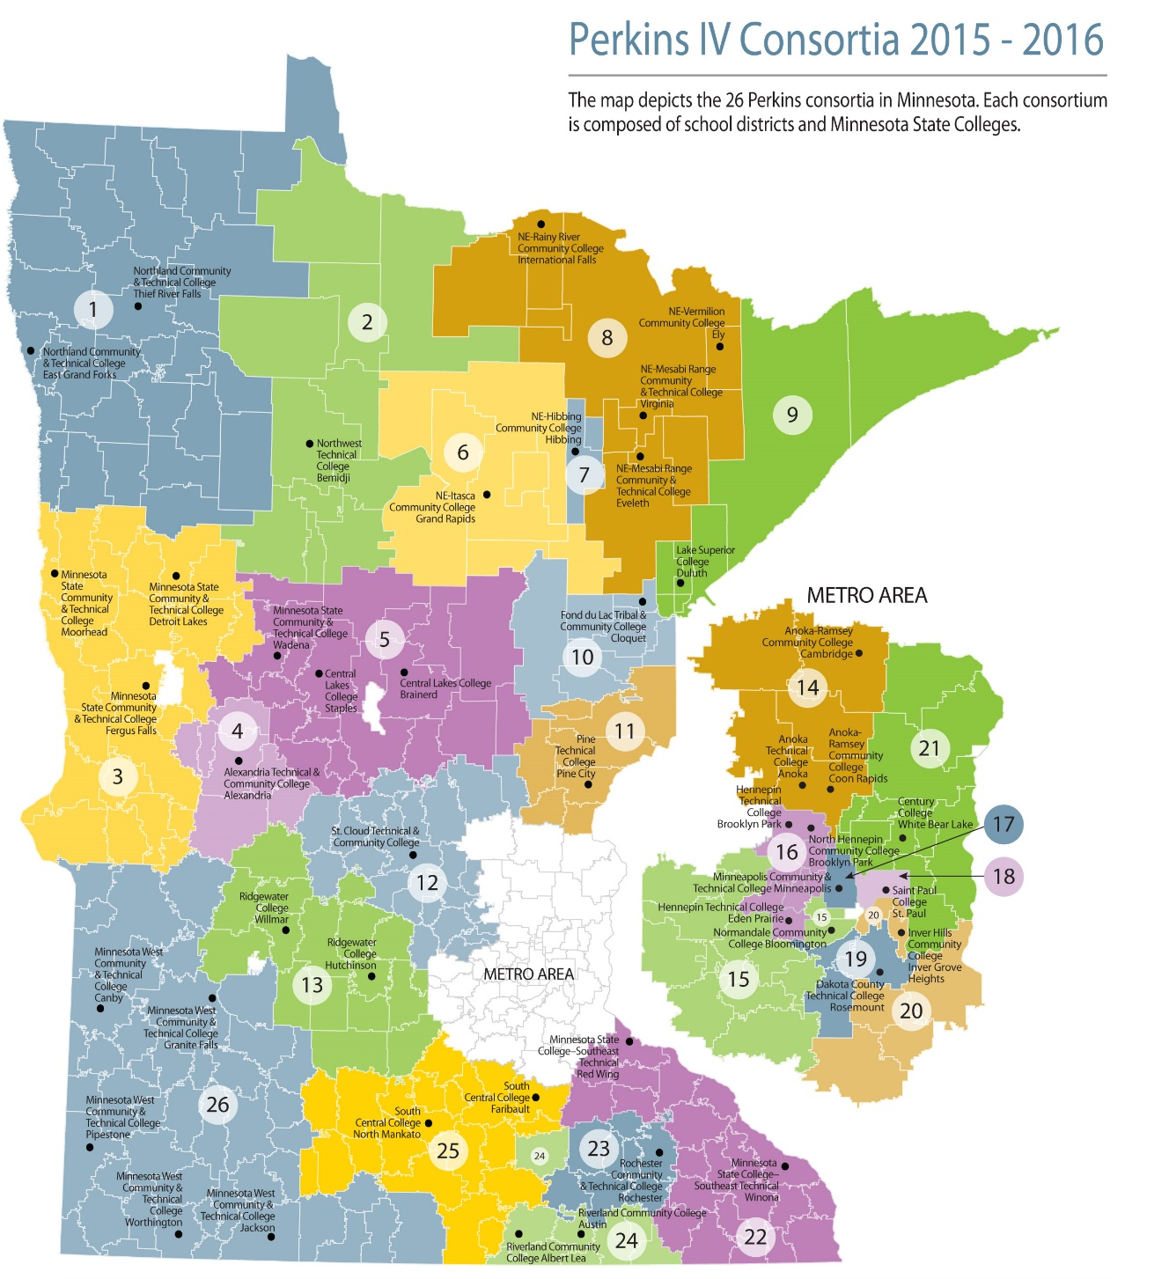
Minnesota Leadership Model: State to Local Consortia
2018-2019
Minnesota State
Local Perkins Consortia
MN Department of Education
Notes:
The secret sauce of Perkins success in Minnesota is the interdependence of Minnesota State, Minnesota Department of Education and the local Perkins consortia in executing the grant and leveraging the resource to impact all of career and technical education in Minnesota. The map on the right is an overview of the lay-out of the State’s Perkins consortia.
Each consortium has a minimum of one college and one school district.
We do have one consortium with 43 school districts.
You can see the organization is geographical. The consortia structure joins our more than343 high schools with the 31 colleges.
Metro “call Out’ maps #17 and #18 above represent our consortia with One College + One District
Minnesota West represents the multiple campuses and multiple districts– 5 campuses/one accredited college and 43 districts
(This map is the reverse side of our state infographic handout that speaks to the students we serve, the increased success of our distinct population when CTE is part of their education, and the profile of our diverse students.)

Slide 4
Current Minnesota Goals (Perkins IV)
Develop rigorous programs of study and career pathways
Partner with business, industry, and local communities
Improve services to special populations
Provide a continuum of service and transition for students
Sustain the consortia model of Minnesota school districts and
2-year colleges
Notes:
The state plan for Perkins IV, the act under which we are operating until June 30, 2019, organizes our work around these four goals.
The “essence” of these goals can also be found in the Perkins V language.

Slide 5
Strengthening Career and Technical Education for the 21st Century Act (Perkins V)
Purpose: Perkins is dedicated to increasing learner access to high-quality Career Technical Education (CTE) programs of study. With a focus on systems alignment and program improvement, Perkins is critical to ensuring that programs are prepared to meet the ever-changing needs of learners and employers.
Notes:
As you can see, the purpose of Perkins V is very much in alignment with the Minnesota goals of Perkins IV and the federal language in Perkins IV. Our work in Perkins V is not starting with a blank slate. Rather, it is an opportunity to build on promising practices from Perkins IV as well as innovate new initiatives to serve our learners.

Slide 6
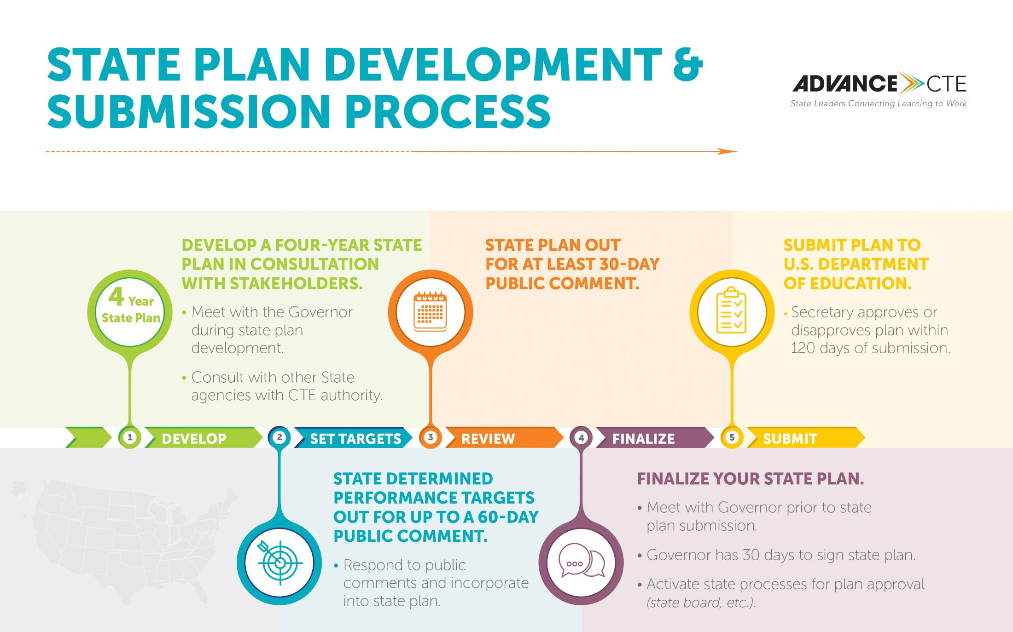
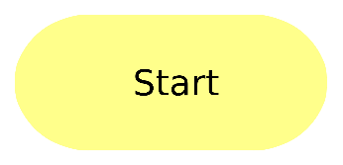
STATE PLAN DEVELOPMENT & SUBMISSION PROCESS
Transition Plan Submitted
April, 2019
4-year Plan Submitted
April, 2020
9/2019
11/2019
1/2020
2/2020
3/2020
July 2020
Begin implementation
Notes:
To “kick off” this process, several of us met the week of November 13 in a regional work session, facilitated by ADVANCE CTE, to begin the foundational pieces of our plan. New to the planning process for Perkins V is the requirement for input from the Governor’s office in the assessment process and a dedicated 30 day review period. You can also see in the diagram that the plan needs to go out for public comment for a minimum of a 30 day time period. We also have a prescribed list of stakeholders who must be consulted in the plan development process.
If we walk backwards with calendars in mind-- Minnesota would want to receive new allocations July 1, 2020 and the U.S. DOE gets 120 days to approve--approximately 4 months. That means we would want to submit by March 1.
However, the governor’s office gets 30 days to review. February 1. Public comments backs us up another 30 days- Jan. 1. Board of Trustee (BOT) review/approval and consultation with Minnesota Department of Education Commissioner. We now need a very solid state plan draft by next year’s CTE Works! So– formal consultation would be summer and early fall.
We will actually submit a transition plan as our application for July 1, 2019 funding. That plan will outline our process for meeting the requirements for the submission of the 4-year State Plan in the spring of 2020.

Slide 7
What is the same?
Purpose and Intent
  FOCUS ON IMPROVEMENT AND INNOVATION
  SUPPORT OF INSTITUTIONS AND PROGRAMS
  New Purpose--Related to increasing employment opportunities for unemployed or underemployed.
Current structure and funding streams
  Title 1-Basic State Grant
Funding formulas
  Federal to state and state to local recipients
Who gets funding
U.S. DOE
MN STATE
LOCAL
Notes:
We are amending Perkins IV with Strengthening Career and Technical Education for the 21st Century. That amended ACT is known as Perkins V.
The transition from IV to V provides a window to examine what has worked well and also to examine what we need/want to accomplish. There’s an opportunity to explore what might be possible under the new act.
There is an opportunity to increase reserve funding and target the usage.
States may invest more in innovation through changes in Reserve Funds;
Perkins V requires that Perkins Reserve funds must be used to foster innovation in CTE and promote programs aligned with high-skill, high-wage or in-demand occupations or industries.
Special Note: Increasing the percentage of funds held for Perkins Reserve activities and/or changing the mechanism by which Perkins Reserve funds are awarded may create some unexpected challenges for states. Increasing the Perkins Reserve set-aside could cause a decrease in the portion of Perkins funds available to flow to local programs through the state’s distribution formula and possibly local recipients’ overall funding level. Additionally, moving from a formula to a competitive grant approach investing in innovation may mean not all eligible recipients receive Perkins Reserve funds.

Slide 8
What’s changed?
CONSULTATION
NEEDS ASSESSMENT
CAREER EXPLORATION
SPECIAL POPULATIONS
WORK-BASED LEARNING
PERFORMANCE ACCOUNTABILITY MEASURES
State Plan
  Expanded consultation
  Governor Sign-off
  Engagement with other agencies
Local Application
  Results of needs assessment
  Courses and activities to be supported, including state-approved programs of study
  Career exploration/career guidance and counseling
  Activities for special populations
  Work-based learning opportunities
  State-set targets for performance accountability measures
Notes:
There is also career awareness/exploration/support ALLOWED in grades 5-8.
Consortia can invest more in innovation through changes in Reserve Funds:
Perkins V requires that Perkins Reserve funds must be used to foster innovation in CTE and promote programs aligned with high-skill, high-wage or in-demand occupations or industries.
Performance Accountability Measures have changed! Some indicators have multiple options for measurement. The state will have to decide, in consultation, which measurement strategy or strategies to use.
Special Note: Utilizing funds held for career awareness/exploration/support which is ALLOWED will cause a decrease in funds for other initiatives. In many districts, grade 5 is elementary. Required expenditures MUST be addressed first.

Slide 9
What’s changed? Required Needs Assessment
NEEDS ASSESSMENT
CONTINUOUS IMPROVEMENT
INNOVATION
Formal needs assessment required
  with consultation
  an evaluation of program alignments to state, regional, Tribal, or local need
  responsive to high-skill, high-wage, in-demand industry sectors or occupations
Notes:
Perkins V Provides a lever to examine old habits and practices including structure and membership of the consortium.
The Act specifies that the state meet five requirements for the Local Comprehensive Needs Assessment:
Evaluation of student performance by subgroup on Perkins core indicators.
• Description of the CTE programs offered (size, scope, quality and alignment).
• Evaluation of the progress toward implementing CTE programs and programs of study.
• Description of recruitment, retention and training for CTE educators and support professionals.
• Description of progress toward implementing equal access to CTE for all students.
This presents an opportunity to use state/regional/local planning process as a mechanism to cultivate stronger ongoing relationships with their stakeholders and bring new stakeholders to the table.
It provides the opportunity to “advance CTE” and make explicit connections between existing initiatives, the state’s vision, and other federal requirements.
Challenge: May increase administrative burden to organize, communicate, etc.
May compress the typical timeline used to write applications.
There is an interdependency of needs assessment to continuous improvement and innovation.

Slide 10

What’s changed? Consultation
Required consultation for the needs
assessment and/or the full plan presents
the opportunity to:
  Become outcome focused
  Respond to feedback
  Strengthen and build new partnerships
  Boldly move from compliance to improvement
  Be a change agent
Notes:
In the needs assessment requirement and in consultation, we need to be mindful of other federal laws/acts that must align with our work.
Specifically, the Workforce Innovation and Opportunity Act (WIOA) and the Every Student Succeeds Acts (ESSA) have elements that will inform the needs assessment.
There are also lead individuals in the region or district who have the expertise to inform and assist the work of the local consortium

Slide 11
What’s changed? Special Populations
PURPOSE (Sec. 1) Specifies one of the purposes of the Act is to develop more fully the academic knowledge and technical employability skills by increasing the employment opportunities for populations including:
  individuals with disabilities
  individuals from economically disadvantaged families, including low-income youth and adults
  individuals preparing for non-traditional fields
  single parents, including single pregnant women
  English learners
  out-of-workforce individuals
  homeless individuals
  youth who are in, or have aged out of, the foster care system
  youth with a parent who is a member of the armed forces and is on active duty
Notes:
Perkins V : Expanded Purpose and definition. The orange, bold font represents expanded populations now in the Perkins V definition for special populations.
PURPOSE (Sec. 1) Specifies one of the purposes of the Act is to develop more fully the academic knowledge and technical employability skills by increasing the employment opportunities for populations who are chronically unemployed or underemployed, including individuals with disabilities, individuals from economically disadvantaged families, out-of-workforce individuals, youth who are in, or have aged out of, the foster care system, and homeless individuals.
DEFINITION (Sec. 3) SPECIAL POPULATIONS - individuals with disabilities; individuals from economically disadvantaged families, including low-income youth and adults; individuals preparing for non-traditional fields; single parents, including single pregnant women; out-of-workforce individuals; English learners; homeless individuals described in section 725 of the McKinney-Vento Homeless Assistance Act (42 U.S.C. 11434a); youth who are in, or have aged out of, the foster care system; and youth with a parent who is a member of the armed forces and is on active duty.

Slide 12
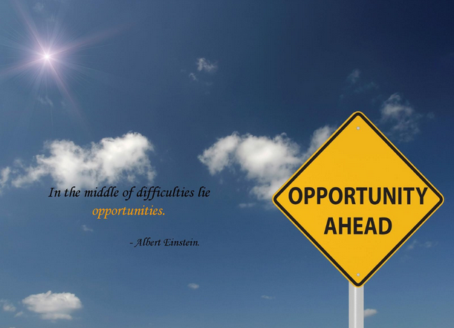
Notes:
Moving from Perkins IV to Perkins V presents the opportunity for examining critical decision points in ensuring CTE systems are high-quality, efficient and aligned with industry demands. The decision points fall into three large buckets:
Program Planning
Program Funding
Program Impact and Accountability
There is an opportunity to leverage the flexibility of Perkins V to improve and expand our systems, programs, and services. Perkins V Provides a lever to examine old habits and practices including structure and membership of the consortium.
Coordinating the development of a shared vision provides opportunities to :
- Align stakeholder engagement plans
- Align use of labor market information
- Review/plan accountability systems
- Leverage opportunities to define and increase program quality
Note: Reflect on the “line in the sand” regarding districts and colleges expecting “their” share of Perkins dollars and their traditional use of funds. This should be the result of the joint, collaborative plan of the consortium. Use Perkins V as that lever to make changes.

Slide 13
Minnesota’s Planning for Perkins V
Vision
Advancing career and technical education empowers every learner to realize a rewarding career
Mission
Quality career and technical education ensures every learner has equitable access to career-connected learning through a network of knowledgeable partners
Principles:
We are committed to ensuring
An equity lens for all decision-making
Inclusion of all stakeholders
Being bold, innovative, and focused on continuous improvement
Responsiveness to the evolving labor market
Notes:
This slide is a working draft from the initial Perkins V Minnesota planning team who attended Region C Perkins Planning facilitated by Advance CTE, NAPE, OCTAE, ACTE. Representatives included Minnesota State, MDE, MACTA, MnACTE, consortia leaders- secondary and postsecondary, and ABE.
Process: planning group with assistance from Advance CTE, NAPE, ACTE proposed these elements. This is just the beginning. We will continue to seek input from many stakeholder groups.

Slide 14
Planning for transitions to Perkins V: Strategic Directions
Advancing CTE
Comprehensive Needs Assessment
Career-Connected Learning
Career Pathways
Integrated Network
Business and Industry
Knowledgeable Experts
Equity and Inclusion
Accountability
Outreach
Awareness and communication
Career Preparation
State and federal programs; state agencies
Educational Partners
Consortia / Minnesota State / MDE
Service Partnerships
Providing resources
Data/data management
Professional Development/technical assistance
Licensure Preparation Programs
Mentor/mentee relationships
Consortia Leadership
Notes:
The elements under each strategic direction will continue to undergo refinement as our work progresses.
It’s the start of the talking points.
Continued work of the planning group will occur throughout the process.

Slide 15
Jan. 2019 Transition Plan reviewed by BOT / MDE
Feb. 2019 Performance Indicator research and target projections
March 2019 Governor’s Office review
April 2019 Submission of Transition Plan to Federal DOE
July 2019 Receipt of State Allocation and Distribution to Local Consortia
Perkins V Transition Planning for MINNESOTA
TIMELINE
Strategic direction work teams throughout to build full 4-year plan
Notes:
In review- here’s a Visual of timeline for transition plan so you can look ahead.
BOT = Minnesota State Board of Trustees
MDE = Minnesota Department of Education

Slide 16
May-Sept 2019 Engaging Stakeholders/Consultation
February 2020 Review by Governor’s Office
December 2019 Review by BOT/MDE
April 2020 Submission of Full 4-year Plan
July 2020 Receipt of State Allocation
Perkins V Four-year Plan for MINNESOTA
TIMELINE
Notes:
Looking ahead, here’s the visual of the timeline for the 4-year plan.
BOT = Minnesota State Board of Trustees
MDE = Minnesota Department of Education

Slide 17
Local Consortium
What are your individual points of pride?
  E.g. Performance indicators
  Outstanding partnerships
  Innovative activities
Who are your key stakeholders?
What opportunities exist to provide consultation?
Notes:
The next two slides are your opportunity to engage and empower participants at the local level.
Use the above questions as simply a suggestion to start those conversations.
You can delete, use them all, or customize.
Best of luck!

Slide 18
Local consortium
What has worked well in your current Perkins work?
Should/can these move forward to Perkins V?
What needs review and consideration for change?
Where are your POS in their life-cycle?
Are there new partners you need to approach?
Notes:
The next two slides present is your opportunity to engage and empower participants at the local level.
Use the above questions as simply a suggestion to start those conversations.
You can delete, use them all, or customize.
Best of luck!

