Slide 1
Centers of Excellence – 101
Advanced Manufacturing
August 18, 2020

Slide 2
Jeremy Leffelman
Executive Director
Minnesota State Advanced Manufacturing
Center of Excellence
Jeremy.leffelman@bemidjistate.edu
t: 218.755.4222 | mnmfg.org
Follow us: Facebook | Twitter | LinkedIn

Slide 3
Advanced Manufacturing Center of Excellence
Founded in 2006, hosted at Bemidji State University, serving all Minnesota State colleges and universities
One of 8 Centers in Minnesota, focused on advanced manufacturing
24 technical and community colleges throughout Minnesota that offer certificate and degree programs in manufacturing
3 strategic priorities : Engaging Industry | Enhancing Education | Inspiring Students
Working with manufacturing associations, manufacturers, Minnesota State colleges and universities, and other stakeholders
Our mission is to promote manufacturing careers and build pathways that lead individuals to rewarding employment in the industry
Notes:
The Minnesota State Advanced Manufacturing Center of Excellence was founded in 2006, and is funded by Minnesota State colleges and universities, and partially by the National Science Foundation.
There are 8 centers in the state of Minnesota, each focused on an important industry sector – other centers include Agriculture (northern and southern), Energy, Engineering, Healthcare, Information Technology, and Transportation. All Minnesota State centers are aligned with three strategic priorities:
Engaging Industry | Enhancing Education | Inspiring Students
We do this in a number of ways, including partnering with manufacturing associations on projects, working on curriculum development and faculty professional development, and inspiring youth to pursue rewarding manufacturing careers through the statewide Tour of Manufacturing and our youth outreach initiatives.
Our mission is to promote manufacturing careers and build pathways that lead individuals to rewarding employment in the industry.

Slide 4
Minnesota State COE | Strategic Priorities

Slide 5
01
Inspiring students | career exploration

Slide 6
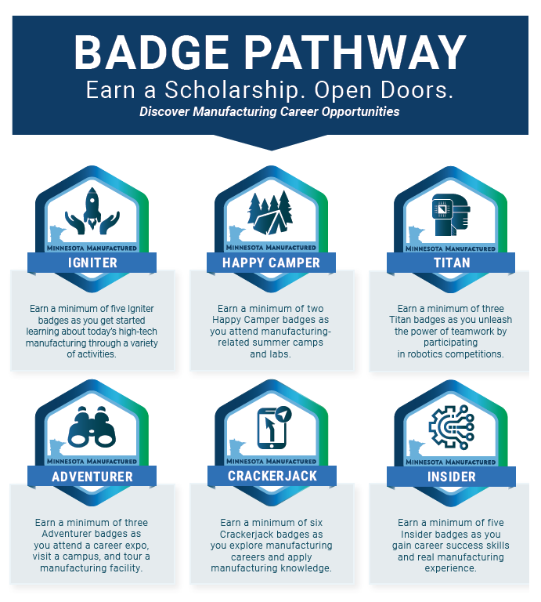
Inspiring Students | Career Exploration
The Center provides multiple ways to inspire students and expose them to manufacturing careers.
Manufacturing Career Tool
Digital Badge Pathway
Statewide Tour of Manufacturing
Youth Outreach events
https://mnmfg.org/students/
Notes:
Manufacturing Career Tool
20 question quiz that aligns student interest with manufacturing careers
Provides manufacturing facts, and environmental considerations
Provides videos of various manufacturing careers students can explore
Digital Badge Pathway
Digital representation of accomplishments
Shows activities, knowledge and skills earned
Cannot be faked – credentials are uniquely embedded within each badge
33 badges, 6 medals
Digital backpack or portfolio
Eligible to apply for 1 of 4 360 eTECH scholarships
Statewide Tour of Manufacturing
Held throughout the year, focus is in October with Manufacturing Week
Students, teachers, general public tour facilities throughout the state
2019 tour, 28K attendees, 208 manufacturers hosted at least one tour, over 640 total tours took place
Purpose is exposure to manufacturing and careers
Center Youth Outreach Events
Robotics camps
Career fairs
Welding camps
Machining camps
Robotics tournaments

Slide 7
02
Educator resources

Slide 8
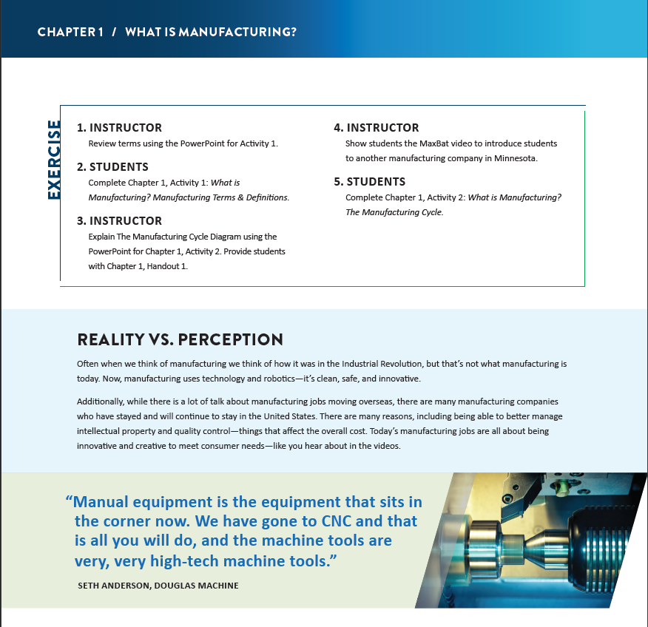
Educator Resources
The Center offers multiple resources at no cost to both secondary and post-secondary educators.
Teacher Guide
Robotics Coaching Guide
Employability Skills Modules
https://mnmfg.org/educators/
The Center manages an online and hands-on manufacturing education program 360 eTECH, serving HS, college, and adult workers.
https://mnmfg.org/programs-courses/
Notes:
Teacher Guide
Comprehensive curriculum for secondary educators
Can be infused into existing curriculum, or be used as standalone lessons and topics, to introduce students to manufacturing careers
Great for alternative schools or programs that offer more flexibility with curriculum
Full of engaging projects with minimal materials
Each chapter includes applicable educational standards for Science, Technology and Language Arts.
Includes teaching objectives, talking points, and various activities to engage a variety of learning styles.
Guide offers exercises outlining the instructor’s role and student’s assignments.
Activities are thorough, offering directions and are designed to be easily printable.
Robotics Coaching Guide
16-page resource for robotics coaches
Discussion of competitions
Engaging manufacturers
Establishing partnerships
Community engagement
Fundraising ideas
Employability Skills Modules
26 modules
Example topics include problem solving, conflict resolution, teamwork, critical thinking, productivity
Lessons, quizzes, videos
All or part can be infused in to existing curriculum, or as standalone

Slide 9
Jeremy Leffelman
Executive Director
Minnesota State Advanced Manufacturing
Center of Excellence
Jeremy.leffelman@bemidjistate.edu
t: 218.755.4222 | mnmfg.org
Follow us: Facebook | Twitter | LinkedIn

