Slide 1
New Secondary Data Reports
Kari-Ann Ediger | Results Measurement
September 3, 2020

Slide 2
Agenda Topics:
Timeline: when will I be able to access the new reports?
Data Sources: where do the data come from?
EDIAM Security System: how do I (and my districts) access the reports?
Performance Indicators: what am I accountable for?
Organization of Perkins V Reports: what reports will be available?
  Accountability
    Enrollment Data (Element #5)
    Performance Data (Element #9)
  Continuous Improvement
Gaps: what are they?
Data Privacy: who can I share student information with?

Slide 3
Timeline

Slide 4
Timeline
Data Availability
Accountability Webinars |  | September 2020
All P-file data submitted to MDE |  | September 2020, for SY2019-20
Performance Indicator data available |  | December 2020
CAR Reporting
 | December, FY2019 | Final Perkins IV year: Enrollment data only (reports available)
 | December, FY2020 | Transition to Perkins V: Enrollment data & Baseline PI data
 | December, FY2021, Perkins V: Year 1 | Report 2020-21 Enrollment, Performance Indicators & Targets
 | December, FY2022, Perkins V: Year 2 | Report 2021-22 Enrollment, Performance Indicators & Targets
 | December, FY2023, Perkins V: Year 3 | Report 2022-23 Enrollment, Performance Indicators & Targets
 | December, FY2024, Perkins V: Year 4 | Report 2023-24 Enrollment, Performance Indicators & Targets

Slide 5
Data Sources

Slide 6
Special Populations
Data Element | Source
Race/Ethnicity | MARSS
Gender | MARSS
Special Education | MARSS
Economically Disadvantaged | MARSS
Non-traditional | CP Web application system/see also Table C
Single Parent | Self-Report (P-file)
Out of Workforce | Self-Report (P-file)
English Learners | MARSS
Homeless | MARSS
Youth in Foster Care | Department of Health
Parent in Active Military | N/A
Migrant | Migrant database

Slide 7
Data Sources: Perkins V
Data Submission: 343 secondary districts, who implement state-approved CTE programs taught by licensed CTE instructors. Districts annually submit their P-file (Perkins) data to Minnesota Department of Education (MDE) via a secure web-based system.
P-file Data submitted to MDE
MARSS
Migrant Flag
SLEDS
MCA/ MTAS
Dept of Health
Data are Aggregated and Verified: Final P-File data are aggregated into the Carl Perkins Database and are verified using the Minnesota Automated Reporting Student System (MARSS) (e.g., using MARSS-ID#, Name, Birthdate, Gender).
Perkins data are linked with additional sources:
  MARSS: student demographics and completion
  MCA/MTAS: Achievement outcomes
  Migrant Flag
  SLEDS: placement/postsecondary enrollment & employment
  Dept of Health: Foster Student information

Slide 8
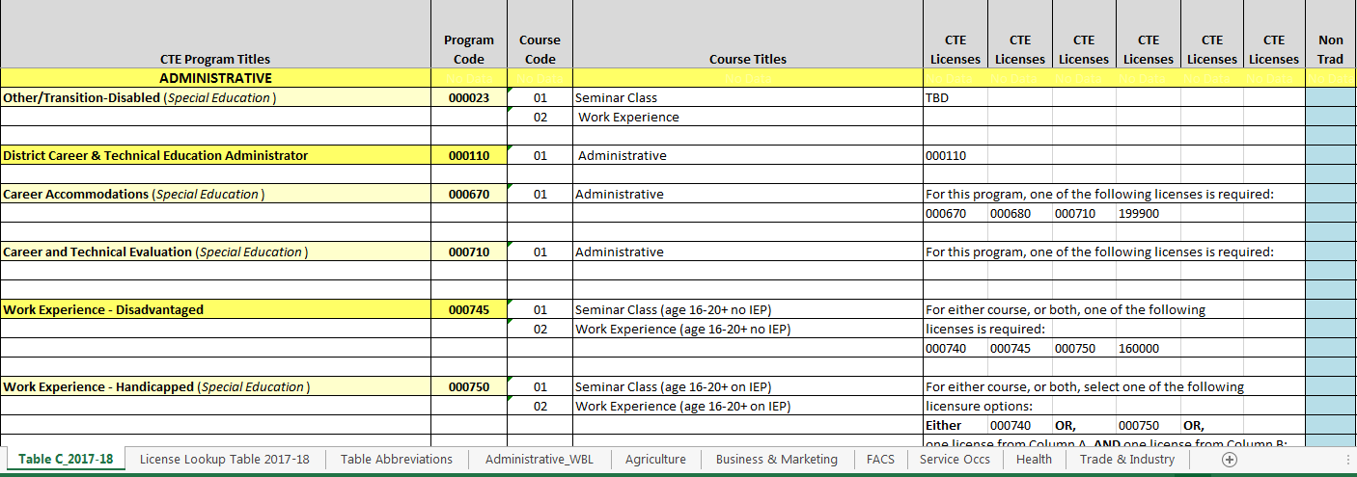
Program Approval and Table C
Table C: Program, Course Codes, Teacher Licensure information
https://education.mn.gov/MDE/dse/cte/progApp/
And, the Program Approval Database which lists all the 6-digit Program Codes and 2-digit Course Codes for all your districts’ Approved Programs (updated annually by 1st week in April). https://education.mn.gov/MDE/dse/cte/progApp/
Recent updated: Summary tabs

Slide 9
In the beginning there was Program Approval…
MN Rule 3505
5year cycle
Don’t wait to Update! –new form coming soon {watch the bi-weekly listserve for the announcement of availability}
What triggers a Program Approval Amendment? New course, New teacher
Send in: Amendment Form and syllabus (to the Program Approval e-inbox)

Slide 10
Schedule of updates to Table C
Content Area | Piloting the process: All cycle year PA’s use new codes New codes seen on Reports | Updating cycle complete: Public-facing and programmed Table C updated All Perkins data reported using updated codes
Family Consumer Science | Cycle Nov 5, FY17. Reports Dec FY17. | April FY18. Data collection Sept FY18.
Business/Marketing | Cycle Nov 5, FY19. Reports Dec FY19. | April FY20. Data collection Sept FY20.
Trade & Industry | Cycle Nov 5, FY20. Reports Dec FY20. | April FY21. Data collection Sept FY21.
Work-based Learning | Cycle Nov 5, FY20. Reports Dec FY20. | April FY21. Data collection Dec FY21.
*Health Technologies | Cycle Nov 5, FY21. Reports Dec FY21. | April FY22. Data collection Dec FY22.
*AFNR | Possible updates FY21. | Possible updates FY22.
*Family Consumer Science | Possible updates FY21 or FY22. | Possible updates FY21 or FY22.
Career Field specialists work with teachers so that those who are submitting Program Approvals within a given cycle year are aware of the (proposed) changes in Table C.
Data specialist communicates with data reporters in the field so that they are aware of the program/course code updates.

Slide 11
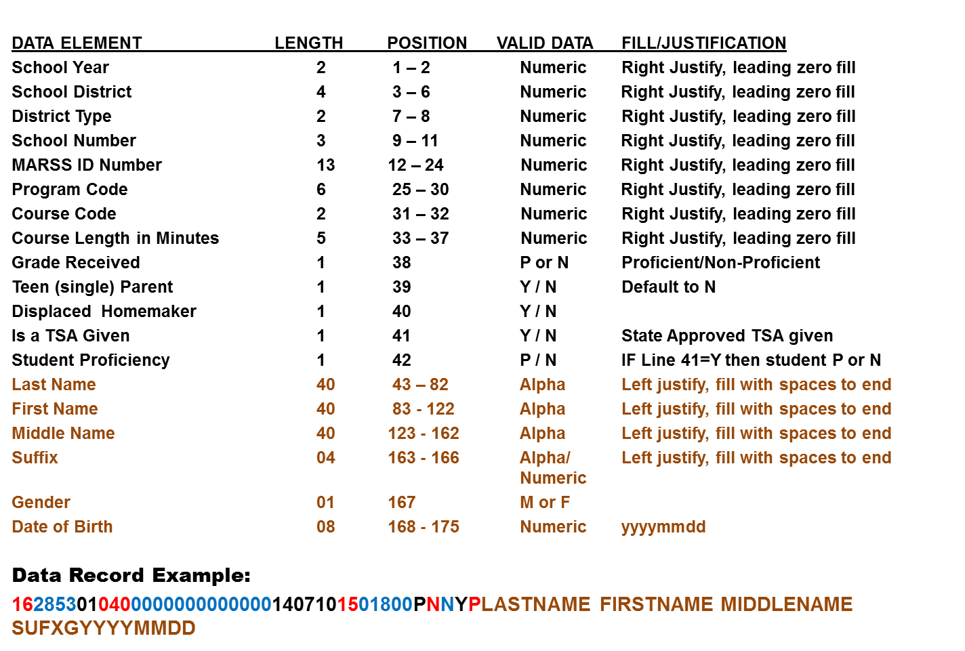
Carl D. Perkins Record Layout 2020
20
.

Slide 12
EDIAM Security

Slide 13
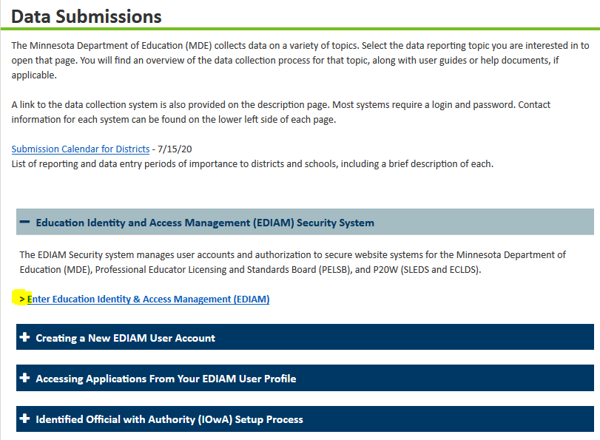
EDIAM Security System
Everyone needs to set up an
EDIAM account
https://education.mn.gov/MDE/dse/datasub/
Superintendent/IoWA Steps:
*NOTE: Make sure your person has an EDIAM
account set up, then…
>Sign into your EDIAM account
>Select, EDIAM Authorizations
>Select, User Search (from the ribbon at the top)
>Search for your person either by email or UserID
>Select, Add User Role
>Select, Carl Perkins (and/or Carl Perkins Secure Reports)
>Click on, Select Application
>Select, User role
>Select, Authorize Role
>your done!

Slide 14
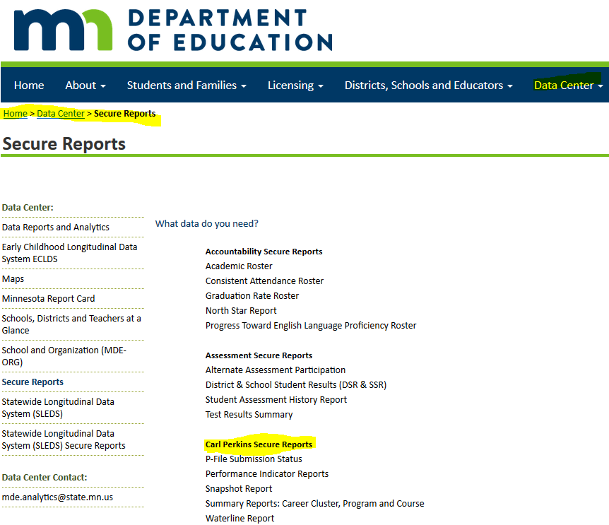
EDIAM gives you access to Carl Perkins Secure Reports
From MDE’s main page/ribbon:
>Select, Data Center
>Select, Secure Reports
>Select the CP report you want
>Sign in using your EDIAM UserID and password

Slide 15
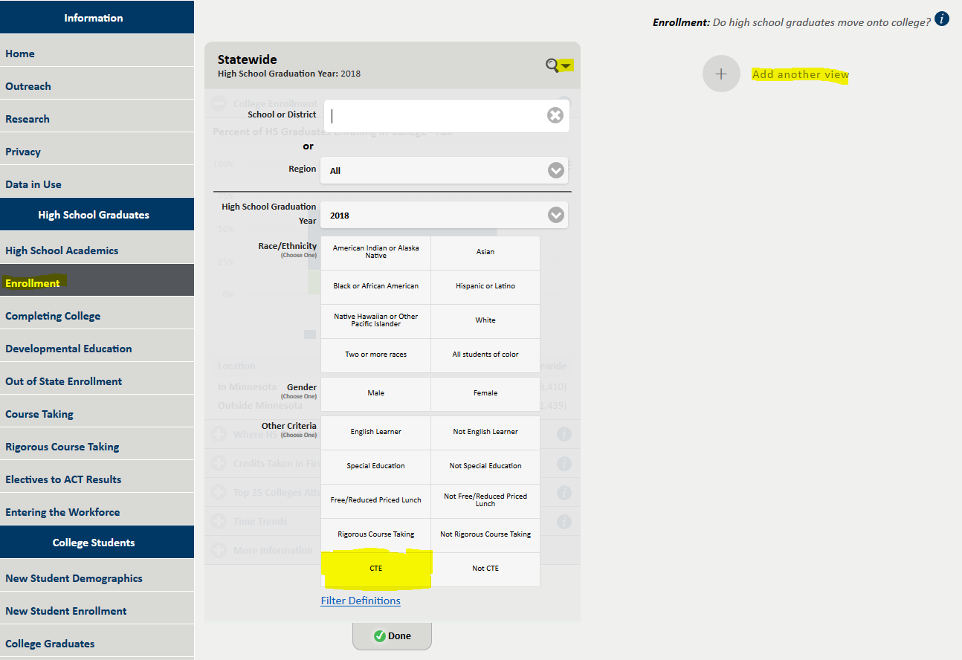
Statewide Longitudinal Education Data System (SLEDS)
SLEDS http://sleds.mn.gov/
From MDE’s main page/ribbon:
>Select Data Center
>Select SLEDS
NOTE: the CTE flag has been updated to represent CTE Concentrators only according to the Perkins V definition of 150+ course hours within a state-approved program, within 1 Career Field.

Slide 16
*New* Accountability Reports

Slide 17
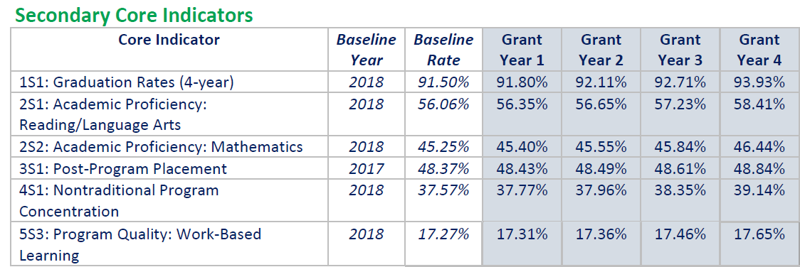
Performance Indicators
Secondary Definitions https://www.minnstate.edu/system/cte/Strengthening-CTE/index.html
Consortium Levels of Performance https://www.minnstate.edu/system/cte/perkins-consortia.html

Slide 18
Overview of Perkins V Reports
Carl Perkins Secure Reports https://public.education.mn.gov/MDEAnalytics/DataSecure.jsp
P-File Submission Status
Accountability
(2) Enrollment (Plan Element #5)
(6) Performance Indicators (Plan Element #9)
Continuous Improvement
Enrollment: Participants & Concentrators
Enrollment: Career Field
Enrollment: Pathway
Enrollment: Course Report
Snapshot
Waterfall

Slide 19
Accountability: Enrollment (CTE Participants)
CTE Participant:
Any 9th-12th grade student who successfully completes one or more courses which are part of a state-approve CTE program.

Slide 20
Accountability: Enrollment (Concentrators)
CTE Concentrator: Any 9th-12th grade student who successfully completes 150+ course hours (or more), which are part of a state-approved secondary CTE program, within one career field.

Slide 21
Accountability: 5S3 Program Quality (WBL)

Slide 22
Accountability: 3S1 Post-Program Placement
NOTES:
a student could be counted as enrolled in postsecondary AND counted as being employed.
Grand Total provides an unduplicated count of students for this performance indicator.
Employment flag in SLEDS:
In the second quarter after graduation,
IF Quarterly Wages Paid is greater than >0, OR if Quarterly Hours Worked are greater than >0 in the calendar year then include that student in the Employment count.

Slide 23
Accountability: Performance Indicators
Gap (from Actual) = Distance from the student group Actual
to the State/Consortium Actual
Gap (from Target) = Distance from the student group Actual to the State/Consortium Actual
Conditional formatting indicates whether the gap is less than 90% of the overall performance relative to the State/Consortium Actual or Target

Slide 24
Gaps: Equitable access and performance outcomes
Perkins V legislation calls on both the state and consortia to annually prepare reports in which they “identify and quantify any disparities or gaps in performance” between categories of students (i.e., gender, race/ethnicity, special populations) and the performance of all CTE Concentrators (Sec. 113, 3.C.ii [state] and Sec. 113, 4,B,ii [local/consortium])
CLNA and Local Plan
Element #5, use the Accountability enrollment reports to note any gaps in overall enrollment and/or enrollment gaps in Career Clusters. Equitable access to CTE and CTE programs.
Element #9, use the Accountability Performance Indicator reports to note any gaps in performance.

Slide 25
Enrollment and Performance gaps:
Perkins data specialists (secondary and postsecondary) are working on compiling guidance for identifying meaningful gaps. However, a few ideas for consideration might be:
Population size:
Is the size of the student group small or large (5 ppl or 500 ppl) relative to the whole population?
Size of the gap:
Does the gap fall outside of 90% of the Actual performance? By how much?
Is the gap for a particular student group consistent across time (persistent gap)?
Is the gap greater in this population than the gap for other student groups?
Or, are there persistent gaps for multiple student groups?

Slide 26
Performance gaps:
Additional considerations:
Outcomes for all students need to increase, however, outcomes for students within an identified gap group need to increase at a greater rate in order to close performance gaps. Once gaps have been identified, it is important to consider your ability to positively impact outcomes for students.
What programs/courses have the highest concentration for that particular student group? In which career fields or pathways are these students enrolling and becoming CTE Concentrators?
What initiatives are local districts already engaging in and demonstrating success? In what ways can CTE provide additional/collaborative support?
For each individual district within a consortium, what gaps are identified within the World’s Best Workforce plan and/or Achievement and Integration plan (if one exists)? Is there a way to partner with current goals and objectives around closing performance gaps.

Slide 27
Continuous Improvement Reports

Slide 28
*New*Continuous Improvement Reports
Enrollment:
Participant & Concentrator
Enrollment:
Career Fields
Enrollment:
Pathway

Slide 29
Enrollment: Participants and Concentrators

Slide 30
Participant and Concentrator Report

Slide 31
Participants and Concentrators

Slide 32
Participants and Concentrators

Slide 33
Participants and Concentrators: Career Field (drill down)

Slide 34
Enrollment: Career Field

Slide 35
Enrollment: Career Fields

Slide 36
Enrollment: Career Fields

Slide 37
Enrollment: Pathway

Slide 38
Enrollment: Pathway

Slide 39
Data Privacy

Slide 40
Data Privacy
Questions about sharing data have come up recently, in particular sharing reports that contain private data
State will be working on guidelines around data sharing
  Certainly anything with a cell size of 10 or less do not share with others.
  If another person has (or is anticipated to have) access your Perkins data, then, that is a good indicator you need a data share agreement (e.g. consultant).
If you have local data sharing agreements or strategies in place that would help inform our guidelines, please send those to Kari-Ann.

Slide 41
Thank you!
Kari-Ann Ediger
Kari-Ann.Ediger@state.mn.us

