Slide 1
Leadership Development
New CTE Instructors:
September 28th Webinar
Good Afternoon!
Please mute your phone.
We will begin shortly.
Carl D. Perkins Career & Technical Education Act of 2006
Notes:
Shelli & Max:
REMEMBER TO RECORD THE WEBINAR!!!
Shelli:
Good Afternoon! Your phone line is muted. If you have a question, type it in the chat box and we will respond to it. There will be a question and answer session at the end of the webinar where we will respond to as many questions as possible. We are also very willing to respond to you individually.
Again, your phone line is muted, type all questions in the chat section and refer to the PowerPoint side number when possible

Slide 2
Perkins Leadership Development Webinar –
New or Recently New
CTE Instructors:
“Welcome to CTE”
Carl D. Perkins Career & Technical Education Act of 2006
Notes:
Shelli:
Good Afternoon ! Welcome to our FY17 Perkins Leadership Development webinar! This webinar is intended for new or recently new CTE instructors in Minnesota.
We are pleased that you are able to join us today. We have titled this webinar, “Welcome to CTE”.
We know that many of you have been teaching in a career & technical education program now since late August or early September. Some of you have been teaching but not in career & technical education. Some of you may even have come directly from industry, and this is your first experience teaching your craft. Whether you are in business or marketing, information technology or technology education, family and consumer sciences or health science, culinary or transportation, agriculture or career specialist, & the list can go on & on - we know there is much to learn as a CTE instructor. I hope this is a helpful webinar for you, and you get some questions answered and find someone to support you through these next few months and years teaching.

Slide 3
Presenters
Shelli Sowles
CTE Coordinator, Minnesota Department of Education
Max Peterson
Education Specialist, Minnesota Department of Education
Callon Siebenahler
Business Marketing Teacher, South St. Paul High School
Lindsey Brockberg
Agriculture Education Teacher, Mountain Lake High School
Brad Vieths
Vocational Program Coordinator, Duluth Public Schools
Notes:
Shelli:
Introductions

Slide 4
September 28th
New CTE Instructor Webinar Agenda
1. Welcome - New Instructor Initiative
– Shelli Sowles, MDE
2. CTE in Minnesota
– What We Teach - Max Peterson, MDE
– Quick History of CTE – Shelli Sowles, MDE
– CTE Today – Callon Siebenahler, South St. Paul HS
3. Your First Year(s) as a CTE Instructor in Minnesota
– Your First Year Experience - Brad Vieths, Duluth Public Schools
– How Students Learn – Lindsey Brockberg, Mountain Lake HS
– Tool for Your Toolbox – Lindsey Brockberg, Mountain Lake HS
4. Questions/ Comments/ Adjournment
– All Team Members
Notes:
Shelli:
So today we will give you a quick overview of the New Instructor Initiative.
We also hope to give you an overview of career & technical education. A brief history as well as where CTE is today. Can I just add that NOW is a great time to be a part of Career Technical Education in the United States and especially Minnesota.
Our goal of the webinar is to give you an overview of what we teach and the benefits of teaching in career and technical education
We will share what studies show about the first year of teaching. We also will discuss how students learn & share some tools for your instructor toolbox.
Finally we want to introduce you to our professional organization, ACTE and Minnesota ACTE and its affiliate in Minnesota.
Finally we will end the webinar with questions and/or comments.
Once again we will MUTE all participants for the webinar. But feel free to ask a question via the chat line. We will try to answer the question at the end of the webinar.
This webinar is scheduled for one hour. We hope to complete the webinar at 5:00 p.m. We are willing to stay on for further questions.

Slide 5
Resources Today:
ACTE Website Association for Career & Technical Education www.acteonline.org
“Your First Year in CTE: 10 More Things to Know” by John Foster/ Pamela Foster/ Clyde Hornberger/ Kathleen McNally - Published by ACTE - Copyright 2015
Moir’s Curve - Ellen Moir, New Teacher Center, University of California, Santa Cruz
Teaching Resources www.cteonline.org/
***This session is being recorded as a future resource
Notes:
Shelli:
Our discussion today is based on resources on your screen. We will also be sharing more resources with you at the upcoming November 2nd CTE Works! Meeting. I hope you can all be there and we can meet in person:
ACTE website; valuable website for important information; if member, also receive teaching resources & up-to-date information on federal legislation that impacts CTE;
Book, “Your First Year in CTE: 10 More Things to Know”. This book is available through ACTE, our CTE professional association.
We will be giving this book to all new & recently new teachers that attend our upcoming meetings so if you would like a book, please plan to attend one of our future sessions.
Moir’s Curve from University of California, Santa Cruz
General Resources for you as a Career Technical Education teacher

Slide 6

Your First Year as a Career and Technical Education Instructor in MN
Notes:
Max: We are excited that you have chosen teaching as a career path. There are many other professions that may pay more, offer attractive perks, and result in less stress. But those of us who have made it our career would not want it any other way! Today we want to take time to talk to you about your choice of being a CTE teacher & its benefits.

Slide 7
WHY WE TEACH CTE in Today’s Schools & Colleges
Share your occupational experience – its knowledge and skills - with students
Give back to your technical profession and community by teaching
Make a difference or impact on future generations
View teaching as a highly regarded profession
Remember an influential teacher that you respected and appreciated
Notes:
Max: Why did I decide to become a CTE teacher? Many of you have probably asked yourself that question MANY times over the last few months. It is not uncommon to question if you made the right choice, . .especially as a beginning teacher. It certainly isn’t because of the money. . Or because it is such as easy job. When you ask teachers why they decided to be a CTE teacher, there are some common themes that emerge.
Some CTE teachers love their college major or trade and want to share their knowledge and occupational experience with others.
Some CTE teachers have a strong commitment to their profession & want to give back for what they have received. Many CTE teachers began their love for their career field as high school students in CTE student organizations (FFA, Skills USA, FCCLA, BPA, or DECA) and appreciate the impact that that experience made on their lives. Other CTE teachers have spent many years in an occupational profession (health, engineering, construction, transportation, media technology) and want to encourage others to go into a profession that they love.
Many CTE teachers “hear the call” to make a difference for students in our schools and colleges. We want to help others find their career path to success through our occupational fields.
We view teaching as an honored profession. . . .one that many respect. Many adults can not do what you do everyday in the classroom or lab and they admit it. Most of our citizens appreciate the work that we do. This is seen in the support that we get through our elected officials at the local, state, & national level through public funding and foundational grants.
Finally many teachers decided to go into the profession because of a teacher that influenced us. They took extra time to help us, encourage us, and stretch our thinking. Teachers can make a difference in the lives of others. We can influence students to look forward with hope for a successful future.

Slide 8
The Outcomes?
CTE Students:
Gain relevant academic, technical, and employability skills that prepare them for today’s workforce.
Feel a sense of accomplishment and pride in their work.
Become actively engaged in their learning through authentic, project-based experiences.
Notes:
Max:
With this public support, the outcomes for our CTE students is great!
In today’s CTE programs, our students gain relevant academic, technical, and employability skills that prepare them for today’s workforce.
They feel a sense of accomplishment and pride in their work.
And they become ACTIVELY engaged in their learning through authentic, project-based experiences.

Slide 9
CTE: Its Past & Evolution
Late 1800’s – Schools specialized in preparing workers for certain jobs.
Early 1900’s -1920’s – Agriculture schools opened; CTE expanded to adult education & retraining citizens to re-enter for the workforce.
After WWII – Value of technical skills increased.
1960’s & 1970’s – Federal funding to enhance “vocational education”
1980’s & 1990’s – Is CTE about the preparation for work? OR does it provide a concrete, understandable context for learning & applying academic skills? The result was the Carl Perkins Act of 1990.
Notes:
Shelli:
Career and technical education as we know it today has its roots in the founding of the United States. From the start, a strong knowledge base and skill set for citizens were considered important. Throughout the years, CTE’s role has been to prepare students and workers for the workplace as well as address the needs of business and industry.
In the late 1800’s, schools began specializing to prepare workers for certain jobs. Then in the early 1900’s, agriculture schools began to open. Adult education and retraining came after WW1 in the 1920’s. Finally a surge in career and technical education came after WWII when technical skills were needed for defense purposes.
Vocational education was federally funded in the 1960’s & 70’s in order to build technical colleges for high school graduates and adult learners & regional technical centers were established for secondary students. At that time, there was much debate on the mission of career and technical education. Is it just to help students prepare for work, both inside & outside the home? Or is its mission to provide a context for learning the academics?
The result of this debate was the Carl Perkins Act of 1990 that called on schools to integrate vocational and academic education. This theme is still maintained in the requirements of the federal Perkins Act that we follow today.
You can check out the ACTE website for more details on how career and technical education has adapted over time to stay at the forefront of American society from 1776 until today.

Slide 10
CTE: Its Past & Evolution
1960-70’s
7 categories of Vocational Education Teachers
* Agricultural education
* Business education
* Distributive education
Health education
* Family and consumer science
* Technical education
Trade and industry
Notes:
Shelli:
One additional piece on CTE’s past & its evolution is tied to its areas of studies. In the 1960’s & 70’s, there were 7 categories of vocational education. Of these 7, 5 entered CTE through a traditional teacher preparation route. The other 2 typically entered with many years of occupational experience.
In Minnesota, the categories at the secondary level have changed in recent years. Business education & distributive education have merged together to create a Business & Marketing license. Trade & industry currently has 4 categories – construction, manufacturing, communications, & transportation. Revisions in licensure are currently under review.
At the college level, Minnesota State teachers are credentialed based on their academic and occupational experience. Each CTE program requires instructors to be credentialed in the field of study which is administered at the System Office.
Whatever the pathway taken, we value our CTE instructors for their expertise and knowledge in their career field of choice.

Slide 11
Minnesota’s New Direction – Programs of Study
Career Field
Career Cluster
Foundation Knowledge and Skills
Career Pathways
http://www.cte.mnscu.edu
Notes:
11
Callon:
Today’s cutting-edge, rigorous and relevant career and technical education (CTE) prepares youth and adults for a wide range of high-wage, high-skill, high-demand careers.
(Click & each feature of the wheel will be identified)
The Minnesota Career Wheel is one way that these high wage, high skill, high demand careers are being promoted in our Minnesota CTE programs.. It encourages students to consider careers
(Click) In all 6 career fields (6 chunks near the center of the wheel – agriculture/food/& natural resources; business, management, & administration; human services; health science technology; engineering, manufacturing, & technology, & arts, communications, & information systems)
(Click) 16 career clusters (16 areas marked in bold print. Marketing, finance, education and training, manufacturing, and information technology are a few of these cluster names.)
(Click) 79 career pathways (marked in black ink under each cluster).
(Click) Finally the center of the wheel identifies the foundation knowledge and skills that we all integrate into our CTE programs – communications, ethics, leadership, safety, cultural competencies – the list is comprehensive and offers students the employability skills that they need to be successful in today’s workforce.
Hopefully you have seen the Minnesota Career Wheel; it is a great career exploration tool as students make the decision on career choices for their future.

Slide 12
Today’s CTE’s Works!
Content of a CTE Program
Or Course
Academic skills – Need to know – concepts, theories, habits of mind
Foundational skills– Need to
understand – apply theory to a
problem – critical thinking, problem solving, communications, teamwork, leadership, ethics, etc.
Technical skills – Be able to do – hands-on skills and techniques to complete tasks, create, repair, etc.
Notes:
Callon:
In addition to career exploration, Minnesota CTE programs or courses are unique in that it offers curriculum in three separate domains – thinking, feeling, and doing.
The content of any CTE program or course is a combination of 1) academic skills - what students need to know; 2) foundational skills – what students need to understand; 3) technical skills – what students should be able to do. The hands-on skills and techniques to completes tasks, create, repair, etc. has been the unique component of CTE over the years.

Slide 13
Today’s CTE’s Works!
Career and College Readiness
Through Career Pathways
Programs of Study – Sequence of
courses (high school to college) in a
Career pathway
Technical Skill Attainment – Assure students through rigorous curriculum, technical skill assessments, and industry-recognized credentials
Notes:
Callon:
In addition, Minnesota CTE encourages high school CTE programs to connect with college CTE programs within a career pathway. This effort occurs through establishing programs of study from high school to college. Hopefully your CTE director, college dean, or Perkins consortia leader has talked to you about programs of study and how your program can connect with others in a career pathway.
Also CTE programs at both levels are encouraged to assess students skills through technical skill assessments and industry-recognized certifications.
Check with your local administrator or Perkins consortia leader for further information on this initiative. We will also give you further information on this at our upcoming face-to-face regional meetings that are scheduled.

Slide 14
Today’s CTE’s Works!
CTE Student Organizations
BPA Secondary/ Postsecondary – Business
DECA/ Collegiate DECA – Marketing, Management, & Entrepreneurship
FFA/PAS – Agriculture
FCCLA – Family, Community, & Career Leaders of America/ Service Occupations
HOSA – Healthcare
SkillsUSA –Trade & Industry
Notes:
Callon:
CTE student organizations are a strong component of our high school & college programs. Leadership and career development are key goals of these organizations. CTE organizations are also a great way for students to develop employability skills such as communication, problem solving, critical thinking, ethics, and teamwork. Regional, state, & national events are held throughout the academic year for students to meet & compete in their content areas.

Slide 15
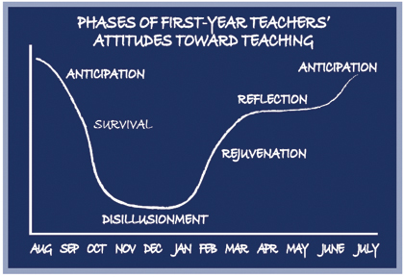
Your First Year as a CTE Instructor
Ellen Moir, University of California – Santa Cruz
Notes:
Brad
First off, welcome to the club! Teaching CTE is by far the most rewarding aspect of education. It is rigorous, relevant, and functional. As a former elementary teacher, social studies teacher, and finally culinary teacher. I can attest that my best teaching was when I was able to tie together my industry experience into a classroom setting. IT will be by far the most challenging and rewarding thing you do.
But it is also VERY VERY hard.
It’s alarming but true: studies have shown that 35% of teachers leave the profession during the first year. By the end of the fifth year, 50% of teachers have left the field! — From Teachers Helping Teachers, Springfield Public Schools, Springfield, MA
The first year of teaching is a difficult challenge. If you are currently in your first year of teaching, the graph above probably applies to you. And you are most certainly not alone! Whether you are currently feeling extremely overwhelmed or abundantly triumphant, other first-year teachers are going through the same thing. The University of California Santa Cruz New Teacher Project led by Ellen Moir has worked to support the efforts of new teachers. They have identified phases through which all new teachers progress. The phases are very useful for mentors and new teachers as they work together the first year. Teachers move through the phases from anticipation, to survival, to disillusionment, to rejuvenation, to reflection, and then back to anticipation.
Anticipation Phase
The anticipation stage begins during the student teaching portion of preservice preparation. The closer student teachers get to completing their assignment, the more excited and anxious they become about their first teaching positions. They tend to romanticize the role of the teachers and the positions. For some of you who might be coming directly from industry. It might be the last couple of weeks before school started when you received your keys, handbooks, and classroom. New teachers enter with a tremendous commitment to making a difference and a somewhat idealistic view of how to accomplish their goals. This feeling of excitement carries new teachers through the first few weeks of school.
Survival Phase
The first month of school is very overwhelming for new teachers. They are learning a lot at a very rapid pace. Beginning teachers are instantly bombarded with a variety of problems and situations they had not anticipated. Despite teacher preparation programs, new teachers are caught off guard by the realities of teaching.
During the survival phase, most new teachers struggle to keep their heads above water. They become very focused and consumed with the day-to-day routine of teaching. There is little time to stop and reflect on their experiences. It is not uncommon for new teachers to spend up to seventy hours a week on schoolwork.
Particularly overwhelming is the constant need to develop curriculum. Veteran teachers routinely reuse excellent lessons and units from the past. New teachers, still uncertain of what will really work, must develop their lessons for the first time. Even depending on unfamiliar prepared curriculum such as textbooks, is enormously time consuming.

Slide 16
Your First Year as a CTE Instructor
TOP 5 CONCERNS OF NEW TEACHERS
Classroom/ Lab Arrangement & Management
Curriculum Planning & Pacing
Establishing a Grading System That is Fair
Parent Conferences/ Student Advising
Personal
Notes:
Brad
Disillusionment Phase
After six to eight weeks of nonstop work and stress, new teachers enter the disillusionment phase. The intensity and length of the phase varies among new teachers. The extensive time commitment, the realization that things are probably not going as smoothly as they want, and low morale contribute to this period of disenchantment. New teachers begin questioning both their commitment and their competence. Many new teachers get sick during this phase.
Top 5 Concerns of New Teachers
1. Classroom arrangement and management
2. Curriculum planning
and pacing
3. Establishing a grading system that’s fair
4. Parent conferences
5. Personal sanity
Compounding an already difficult situation is the fact that new teachers are confronted with several new events and stressors common to teachers but no other careers during this time frame. They are faced with back-to-school night, parent conferences, and their first formal evaluation by the site administrator. Add to that the long hours, correcting workload, limiting of family time, stress of students and their issues in life.
Each of these important milestones places an already vulnerable individual in a very stressful situation. AND are totally normal!!
During the disillusionment phase, classroom management is a major source of distress. The honeymoon is over and now it gets REAL. As New teachers want to focus more time on curriculum and less on classroom management and discipline, it often starts to lead to problems in the classroom. The key here is to always focus on classroom culture and curriculum will come over time.
At this point, the accumulated stress of the first year teachers, coupled with months of excessive time allotted to teaching, often bring complaints from family and friends. This is a very difficult and challenging phase for new entrants into the profession. They express self-doubt, have lower self-esteem, and question their profession commitment. In fact, getting through this phase may be the toughest challenge new teachers face. The key here is to be aware of it. . . Ask for help, prioritize, don’t follow the trend of isolating yourself. . . . You are not alone. . . And it does get better.

Slide 17
Your First Year as a CTE Instructor
Notes:
Brad
Rejuvenation Phase
The rejuvenation phase is characterized by a slow rise in the new teacher’s attitude toward teaching. It generally begins in January. Having a winter break makes a tremendous difference for new teachers. It allows them to resume a more normal lifestyle, with plenty of rest, food, exercise, and time for family and friends. This vacation is the first opportunity that new teachers have for organizing materials and planning curriculum. It is a time for them to sort through materials that have accumulated and prepare new ones. This breath of fresh air gives novice teachers a broader perspective with renewed hope.
Reflections Phase
Every year about May and into June, new teachers and life-long teachers enter the reflection phase. This is a key time where a teacher’s energy has been restored and thoughts about the future of their program is internally assessed. This is a creative time to look at lessons, classroom structure, units or projects and how they fit into the learning targets of the program. This is always the time to make decision on What do I add? What do I remove? For those who PLC, this is also the heart of those meetings: What do I want students to learn? How will I know that they have learned it? What will I do for those who have already mastered it? What will I do for those who are not getting it?
Story: CTE teachers are the BEST at this! We are pragmatic and open to change due to the nature of what we teach and our industry connections. Share Deli, MS shop, and Automotive stories.
Cycle Continues to Anticipation again based on the reflections and changes.

Slide 18
How Students Learn
  Consider how your students learn – What are their strengths? What are their learning styles? How can they share their learning with others in the class or community?
  Use a variety of instructional strategies for the variety of student learning in your class. . . individual assignments, group projects, written documents, oral presentations are all different methods for student learning.
  Student projects should include planning, designing, piloting, implementing , revising, and reporting their accomplishments.
  Use your community as a resource for learning.
  Student work should be assessed with regular feedback from you and others. Personal student evaluation is also important so they can reflect on their work and progress.
Notes:
Lindsey:
Finally the most important tool to keep in mind is know your students. Consider both how they learn best and your philosophy on effective instruction.
Consider how your students learn – What are their strengths? What are their learning styles? How can they share their learning with others in the class or community?
Use a variety of instructional strategies for the variety of student learning in your class. . . individual assignments, group projects, written documents, oral presentations are all different methods for student learning.
Student projects should include planning, designing, piloting, implementing , revising, and reporting their accomplishments.
Use your community as a resource for learning.
Student work should be assessed with regular feedback from you and others. Personal student evaluation is also important so they can reflect on their work and progress.

Slide 19
Tools for Your Toolbox
Planning a course. . .
  Gather information about career pathways or careers related to the course.
  Identify the critical competencies that should be accomplished based on national standards, industry-recognized standards, state frameworks, or common core competencies.
  Identify teaching strategies to accomplish these competencies.
  Determine resources for effective instruction – media, equipment, speakers, field trips, etc.
  Decide what you will assess.
  PLAN with flexibility!!
Notes:
Lindsey:
As a new CTE teacher, you may find yourself ready to teach a class with no course outline or resources. You are not alone! We have all been in that spot. Planning a course outline is a challenge.
Whether you are a new or experienced teacher, flexibility is the key! Remember – your teaching days are rarely the same and often what you plan may not happen. Don’t get discouraged!
As a new CTE teacher, you may find yourself ready to teach a class with no course outline or resources. You are not alone! We have all been in that spot.
Here are some suggestions that might help you as you begin your plan:
Think about the career pathways or careers that are connected to the course description.
Review the core competencies that are essential for that set of careers or occupations. Often this will be the course goals that have been established by your college or school district. There are many resources available to you (textbooks, videos, even YouTube). But it is important to make sure they align with the national standards for your content area. These standards have been reviewed and validated by business & industry partners as well as national education associations.
Based on these standards, identify the major components or tasks you want to include in the course. This are your teaching strategies that you determine will work for you and your students. And always remember, our CTE students are often practical learners. So the real world experiences are often key to their success.
Identify resources that you will use for effective instruction. Variety is key as your students all learn in different ways.
Finally, determine how you will assess through written exams, performance-based assessments, discussions, and participation.

Slide 20
Tools for Your Toolbox
Lesson Planning. . .
  What is the main idea that you want to teach?
  How can you get students’ attention at the start of the lesson and keep them engaged?
  What are the key learning objectives? What should the students know and be able to do?
  What activities will help your students achieve the learning that is to take place?
  How will you assess their learning?
  PLAN with flexibility!!
Notes:
Lindsey:
Daily lesson planning is also an important part of teaching. You may hear your colleagues say that they just “wing it” in their classes. But that is not good teaching!
Lesson planning offers you, the teacher, the opportunity to reflect on what is working and what needs to be changed. Lessons keep you focused on your course goals and outcomes.
Take time to reflect on your daily lessons:
What are my main goals for the day?
How can I get my students’ attention at the beginning of class?
What are the key learning objectives for today? Remember to keep it simple! Always ask yourself what should my student know & be able to do?
What activities will help my students learn?
How will I assess their learning?

Slide 21
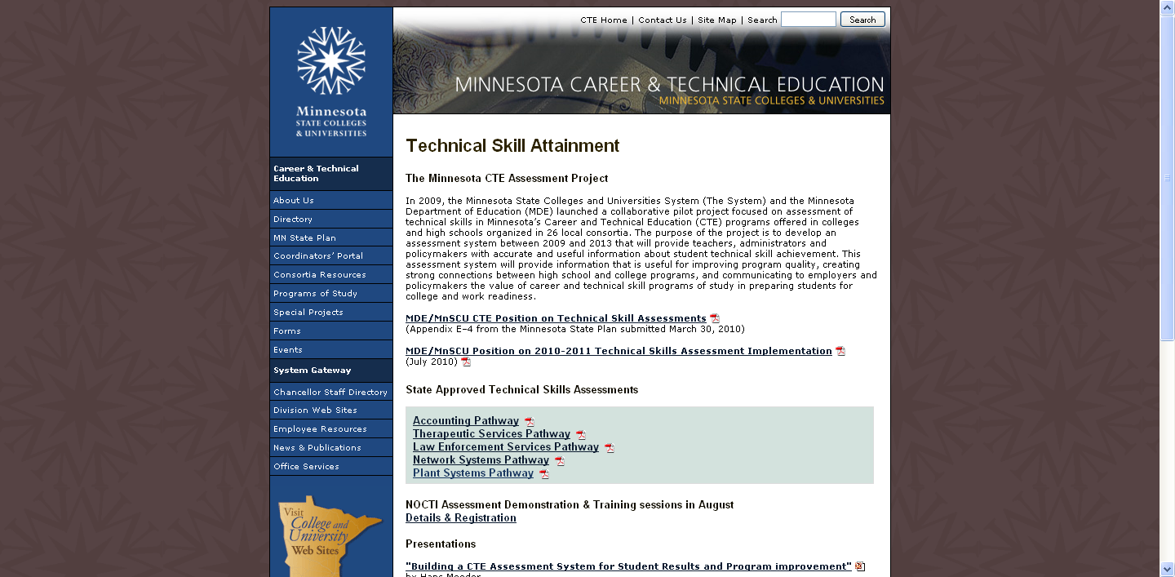
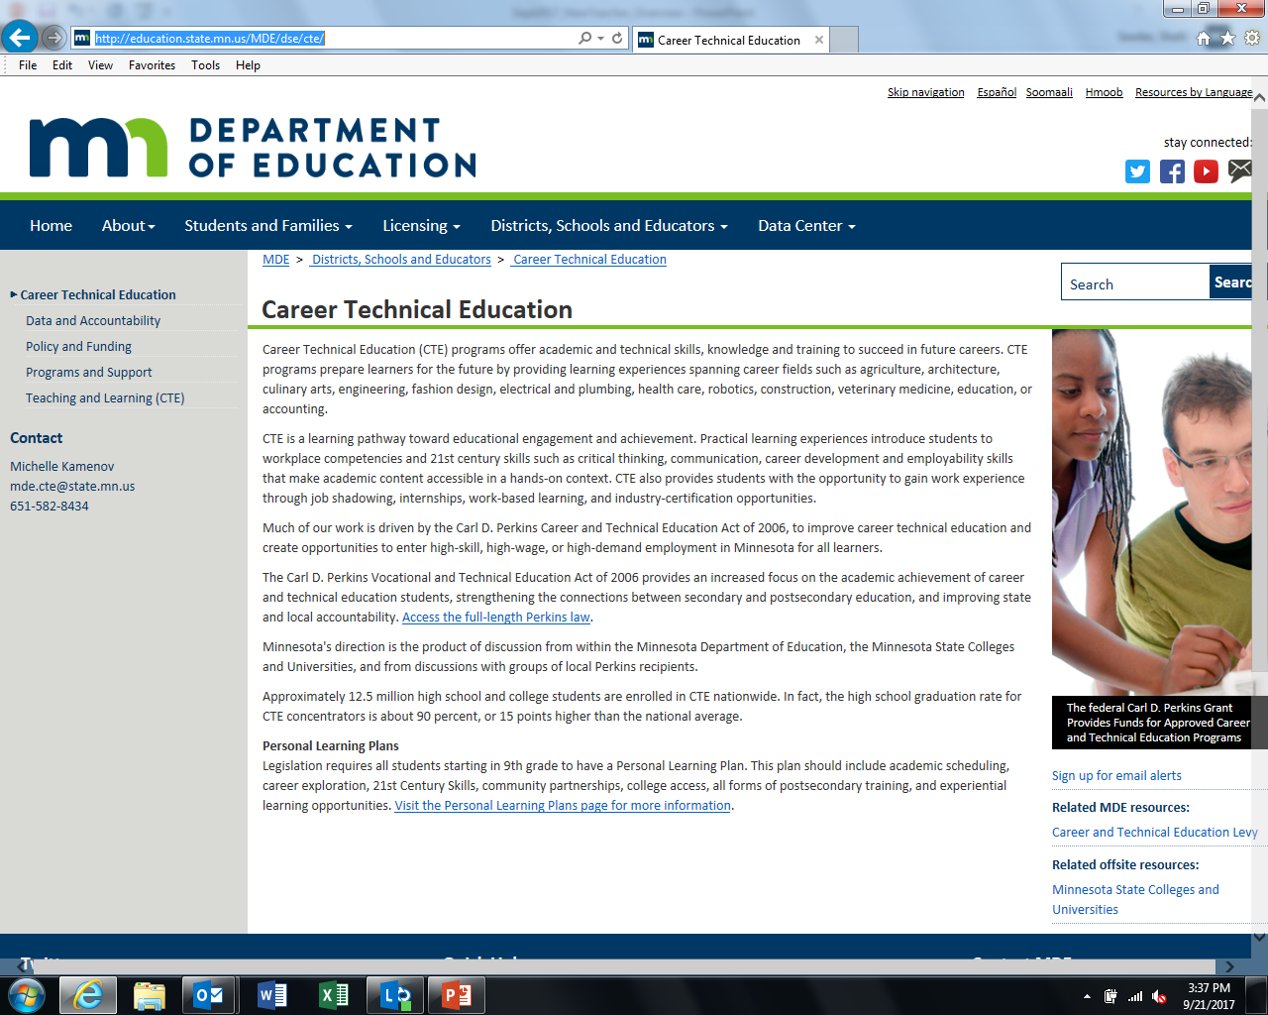
Minnesota Career & Technical Education
www.cte.mnscu.edu education.state.mn.us/MDE/dse/cte/
Notes:
Shelli:
For state resources, feel free to go to the Minnesota Career & Technical Education websites for MDE or Minnesota State Colleges and Universities, www.cte.mnscu.edu or education.state.mn.us/MDE/dse/cte/
These websites give you the latest information on what is happening in CTE in Minnesota. It will also give you resources that you can use as you plan your courses and daily lessons. There is an abundance of information on the Carl D. Perkins grant I spoke about earlier, as well as information on Data, State Policy, Program Support, and Teaching and Learning. You can listen to past recorded webinars for information on other topics as well.

Slide 22
CTE Works! Summit November 2nd
Please plan to join us at the New Teacher session at the CTE Works Summit, from 3:00-4:00 in the Apollo Terrace.
Networking and Resources for New Teachers
Register online at www.cteworksminnesota.org/
Notes:
Shelli

Slide 23

Next Steps - Questions
  Questions?
  Feel free to ask your questions in the comment section.
Notes:
TEAM

Slide 24
Contact Us
shellisowles@state.mn.us
Career & Technical Education Coordinator, Minnesota Department of Education
maxine.peterson@state.mn.us
Education Specialist, Minnesota Department of Education
csiebenahler@sspps.org
Business Marketing Teacher, South St. Paul High School
lbrockberg@mountainlake.k12.mn.us
Agriculture Education Teacher, Mountain Lake High School
bradley.vieths@isd709.org
Vocational Program Coordinator, Duluth Public Schools
Secondary Coordinator Lake Superior Consortium
Notes:
Shelli:
Thank our presenters today

Slide 25
Contact Us
jeralyn.jargo@so.mnscu.edu,
State Director for Career Technical Education
michelle.kamenov@state.mn.us, Supervisor, Office of Career and College Success
denise.felder@so.mnscu.edu,
CTE Professional Development Director
Notes:
Shelli

Slide 26

Notes:
THANK YOU
for participating in this webinar!!

